Slide 1

지진원 특성평가 Characterization of Seismic Sources 2025.4.15~17 국립부경대학교 장보고관
Supreme Course I

Slide 2
지진원 특성평가 Characterization of Seismic Sources - Part I -
Supreme Course I

Slide 3
교육일정 및 내용
1일차 | 교육준비 전산 프로그램 배포 및 설치 교육과정 소개 교육의 목표 및 내용 기초 이론 확률이론의 기초 확률적 추정 (Probabilistic Estimation) 통계적 검정 (Statistical Test) 확률변수의 수치적 모사 (Monte Carlo Simulation)
2일차 | 지진목록 준비 지진원 요소 지진목록 병합 지진목록의 완전성 평가 배경 완전성 평가방법의 분류 지진목록을 이용한 완전성 평가 지진규모 분포모델 지수 모델 특성지진 모델

Slide 4
교육일정 및 내용 (계속)
2일차 (계속) | 지진원 특성평가 - 지진목록 이용 지진원의 종류 및 요소 Richter-b 평가 지진발생률 평가 최대지진 평가 반복적 동시평가
3일차 | 지질 및 측지자료의 이용 최대지진 평가 지진발생률 평가 관련 이슈 지진목록의 병합 효과 지진의 이중 산입 SeisParEst를 이용한 실습 SeisParEst 사용자 지침 지진원별 지진목록 작성: 지진원에 속하는 지진 추출 지진목록의 완전성 평가: 6가지 방법 지진원 특성 평가: 11가지 방법 평가결과의 해석 및 활용
특전 | 동일 단체에서 2인 이상 수강하면, SeisParEst 1년 라이선스 제공

Slide 5
Chapter 0 Introduction

Slide 6

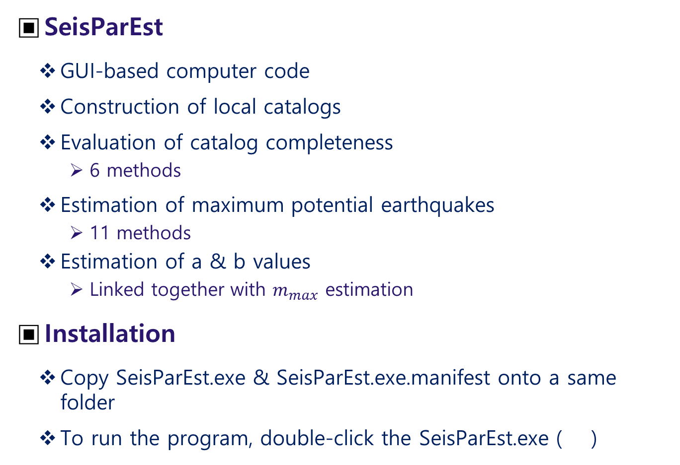
Preparation
SeisParEst
GUI-based computer code
Construction of local catalogs
Evaluation of catalog completeness
6 methods
Estimation of maximum potential earthquakes
11 methods
Estimation of a & b values
Linked together with $m_{max}$ estimation
Installation
Copy SeisParEst.exe & SeisParEst.exe.manifest onto a same folder
To run the program, double-click the SeisParEst.exe ( )

Slide 7
About the Course
Target Trainees
Graduate/undergraduate students
PSHA practitioners
Goals
To understand basic statistical seismology
To evaluate seismicity parameters
Contents
Fundamental Statistics
Construction & Assessment of local catalogs
Estimation of seismicity parameters

Slide 8
Chapter 1 Fundamental Statistics

Slide 9
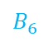
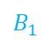
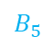
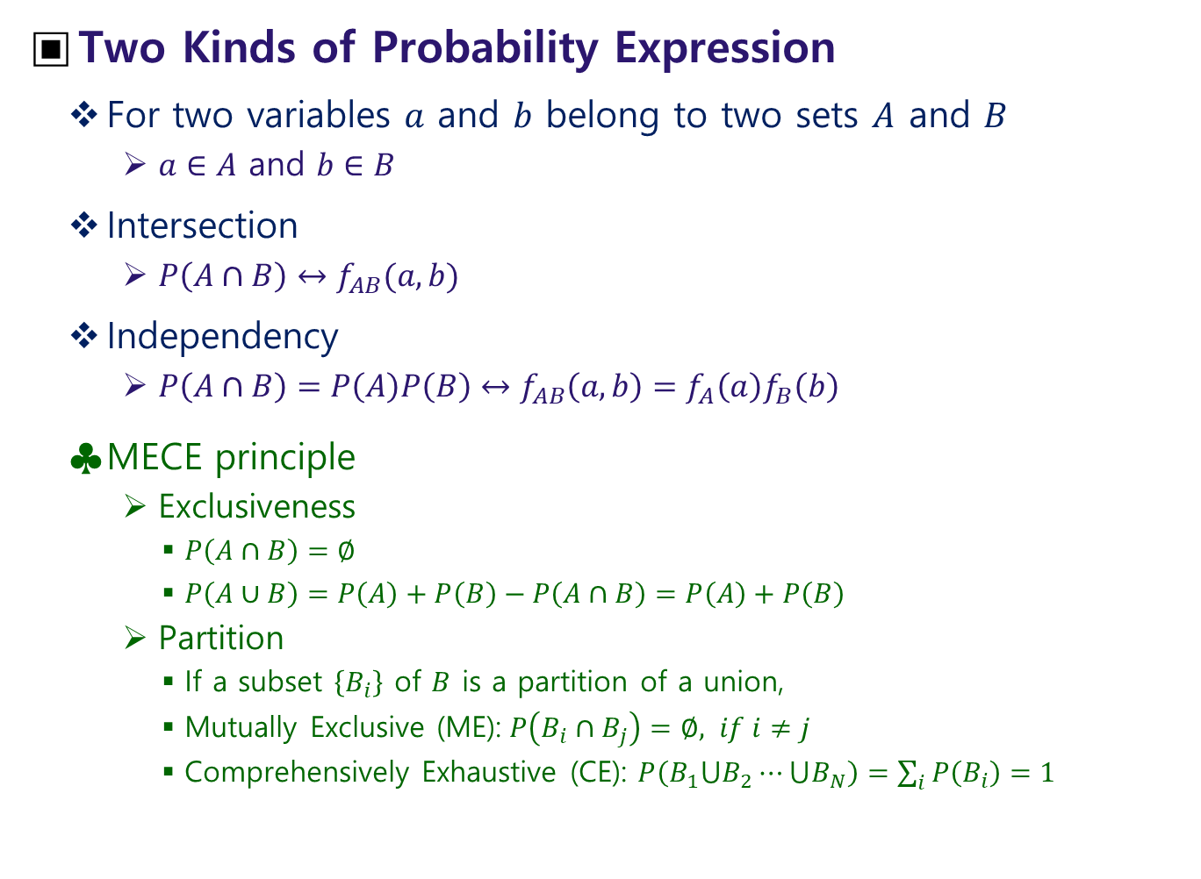
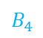

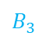
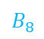
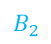
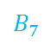
Probability
Two Kinds of Probability Expression
For two variables $a$ and $b$ belong to two sets $A$ and $B$
$a∈A$ and $b∈B$
Intersection
$P\left(A∩B\right)↔f_{AB}(a,b)$
Independency
$P\left(A∩B\right)=P\left(A\right)P\left(B\right)↔f_{AB}\left(a,b\right)=f_{A}\left(a\right)f_{B}\left(b\right)$
MECE principle
Exclusiveness
$P\left(A∩B\right)=∅$
$P\left(A∪B\right)=P\left(A\right)+P\left(B\right)−P\left(A∩B\right)=P\left(A\right)+P\left(B\right)$
Partition
If a subset $\left\{B_{i}\right\}$ of $B$ is a partition of a union,
Mutually Exclusive (ME): $P\left(B_{i}∩B_{j}\right)=∅, if i≠j$
Comprehensively Exhaustive (CE): $P\left(B_{1}⋃B_{2}⋯⋃B_{N}\right)=\sum_{i}{P\left(B_{i}\right)=1}$
$$B_{1}$$
$$B_{5}$$
$$B_{7}$$
$$B_{3}$$
$$A$$
$$B_{6}$$
$$B_{2}$$
$$B_{4}$$
$$B_{8}$$

Slide 10
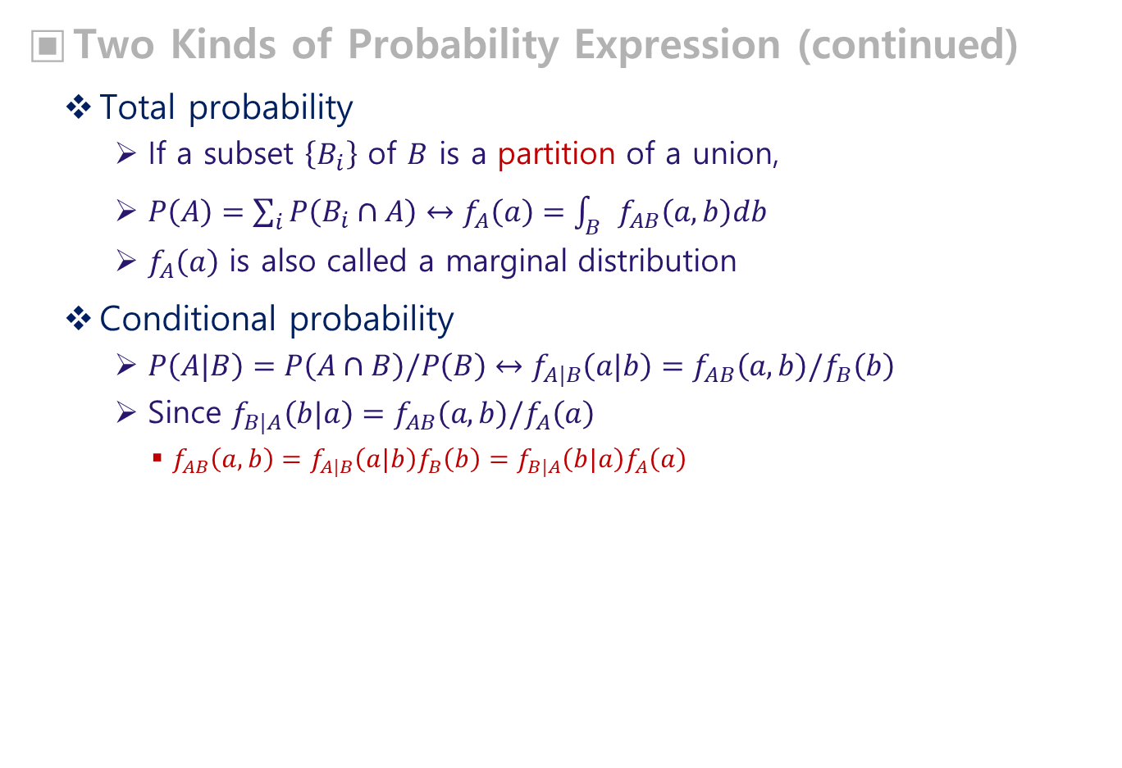
Probability
Two Kinds of Probability Expression (continued)
Total probability
If a subset $\left\{B_{i}\right\}$ of $B$ is a partition of a union,
$P\left(A\right)=\sum_{i}{P\left(B_{i}∩A\right)}↔f_{A}\left(a\right)=\int_{B}{f_{AB}\left(a,b\right)db}$
$f_{A}\left(a\right)$ is also called a marginal distribution
Conditional probability
$P\left(A|B\right)=P\left(A∩B\right)/P\left(B\right)↔f_{A|B}\left(a|b\right)=f_{AB}\left(a,b\right)/f_{B}\left(b\right)$
Since $f_{B|A}\left(b|a\right)=f_{AB}\left(a,b\right)/f_{A}\left(a\right)$
$f_{AB}\left(a,b\right)=f_{A|B}\left(a|b\right)f_{B}\left(b\right)=f_{B|A}\left(b|a\right)f_{A}\left(a\right)$
$$B_{1}$$
$$B_{5}$$
$$B_{7}$$
$$B_{3}$$
$$A$$
$$B_{6}$$
$$B_{2}$$
$$B_{4}$$
$$B_{8}$$

Slide 11
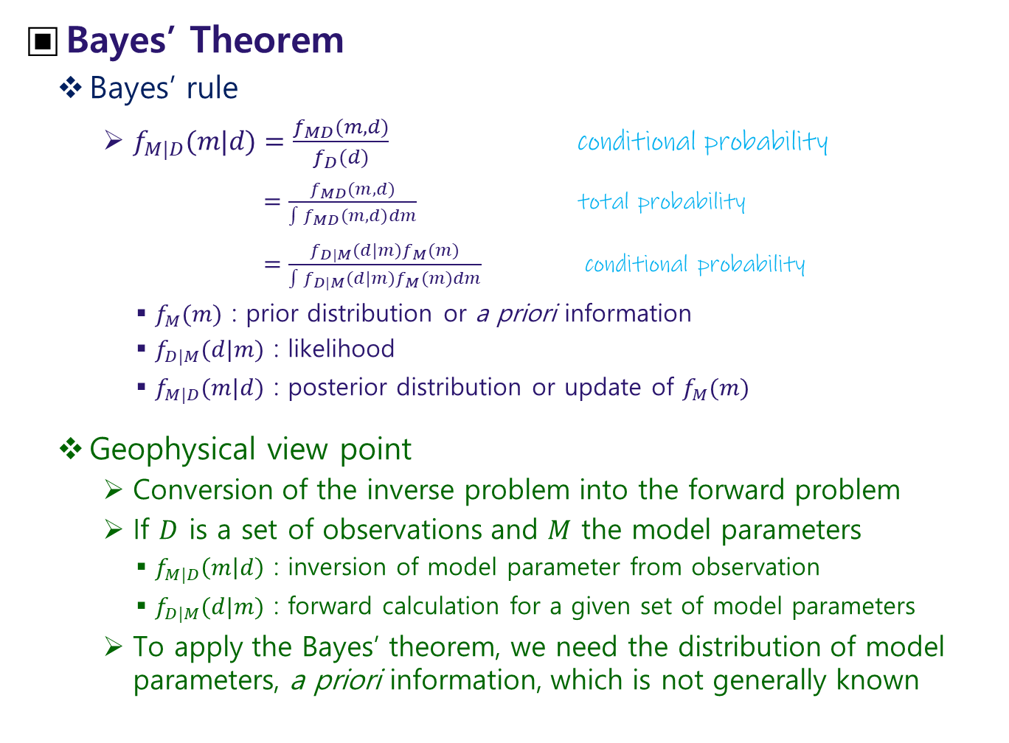
Bayes’ Theorem
Bayes’ rule
$f_{M|D}(m|d)=\frac{f_{MD}(m,d)}{f_{D}(d)}$ conditional probability
$=\frac{f_{MD}(m,d)}{\int{f_{MD}(m,d)}dm}$ total probability
$=\frac{f_{D|M}(d|m)f_{M}(m)}{\int{f_{D|M}(d|m)}f_{M}(m)dm}$ conditional probability
$f_{M}(m)$ : prior distribution or a priori information
$f_{D|M}(d|m)$ : likelihood
$f_{M|D}(m|d)$ : posterior distribution or update of $f_{M}(m)$
Geophysical view point
Conversion of the inverse problem into the forward problem
If $D$ is a set of observations and $M$ the model parameters
$f_{M|D}\left(m | d\right)$ : inversion of model parameter from observation
$f_{D|M}(d|m)$ : forward calculation for a given set of model parameters
To apply the Bayes’ theorem, we need the distribution of model parameters, a priori information, which is not generally known

Slide 12
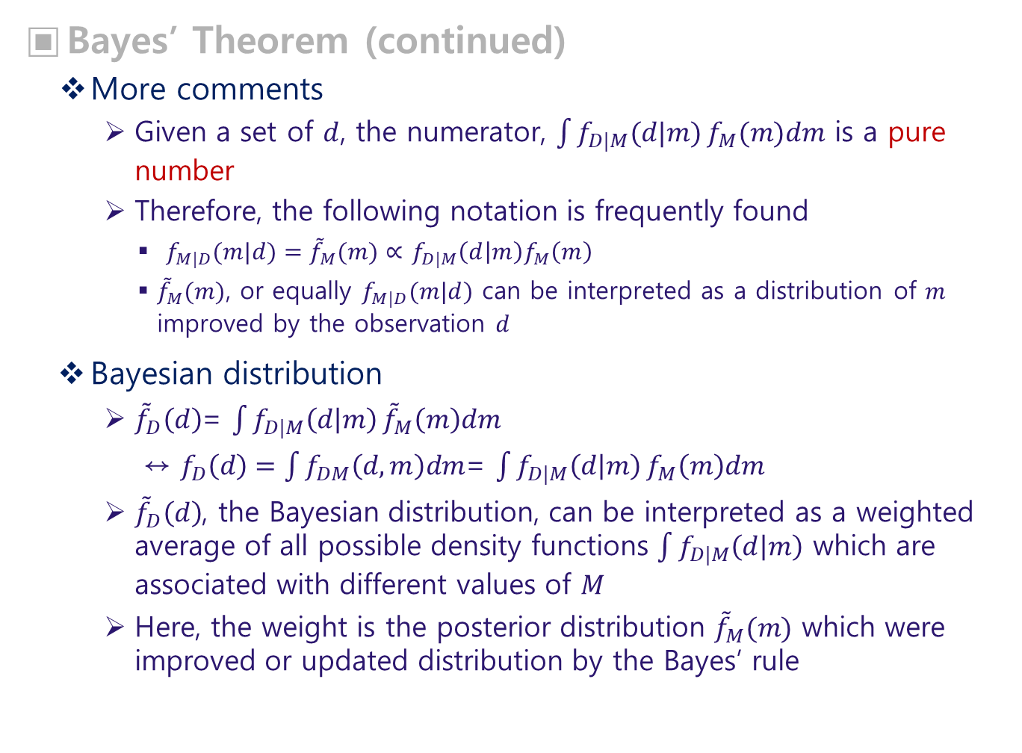
Bayes’ Theorem (continued)
More comments
Given a set of $d$, the numerator, $\int{f_{D|M}(d|m)}f_{M}(m)dm$ is a pure number
Therefore, the following notation is frequently found
$f_{M|D}(m|d)={\tilde{f}}_{M}(m)∝$ $f_{D|M}\left(d | m\right)f_{M}\left(m\right)$
${\tilde{f}}_{M}(m)$, or equally $f_{M|D}(m|d)$ can be interpreted as a distribution of $m$ improved by the observation $d$
Bayesian distribution
${\tilde{f}}_{D}\left(d\right)$= $\int{f_{D|M}\left(d | m\right)}{\tilde{f}}_{M}\left(m\right)dm$
↔ $f_{D}\left(d\right)=\int{f_{DM}\left(d,m\right)dm}$= $\int{f_{D|M}\left(d | m\right)}f_{M}\left(m\right)dm$
${\tilde{f}}_{D}\left(d\right)$, the Bayesian distribution, can be interpreted as a weighted average of all possible density functions $\int{f_{D|M}\left(d | m\right)}$ which are associated with different values of $M$
Here, the weight is the posterior distribution ${\tilde{f}}_{M}(m)$ which were improved or updated distribution by the Bayes’ rule

Slide 13
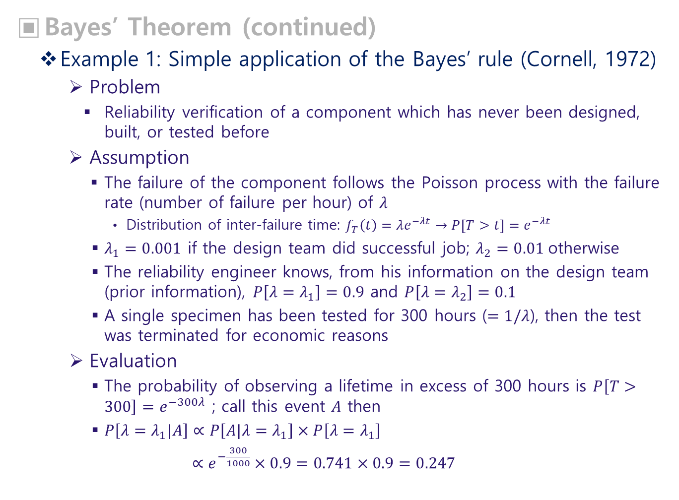
Bayes’ Theorem (continued)
Example 1: Simple application of the Bayes’ rule (Cornell, 1972)
Problem
Reliability verification of a component which has never been designed, built, or tested before
Assumption
The failure of the component follows the Poisson process with the failure rate (number of failure per hour) of $λ$
Distribution of inter-failure time: $f_{T}\left(t\right)=λe^{−λt}→P\left[T>t\right]=e^{−λt}$
$λ_{1}=0.001$ if the design team did successful job; $λ_{2}=0.01$otherwise
The reliability engineer knows, from his information on the design team (prior information), $P\left[λ=λ_{1}\right]=0.9$ and $P\left[λ=λ_{2}\right]=0.1$
A single specimen has been tested for 300 hours ($=1/λ$), then the test was terminated for economic reasons
Evaluation
The probability of observing a lifetime in excess of 300 hours is $P\left[T>300\right]=e^{−300λ}$ ; call this event $A$ then
$P\left[λ=λ_{1}|A\right]∝P\left[A|λ=λ_{1}\right]×P\left[λ=λ_{1}\right]$
$∝e^{−\frac{300}{1000}}×0.9=0.741×0.9=0.247$

Slide 14
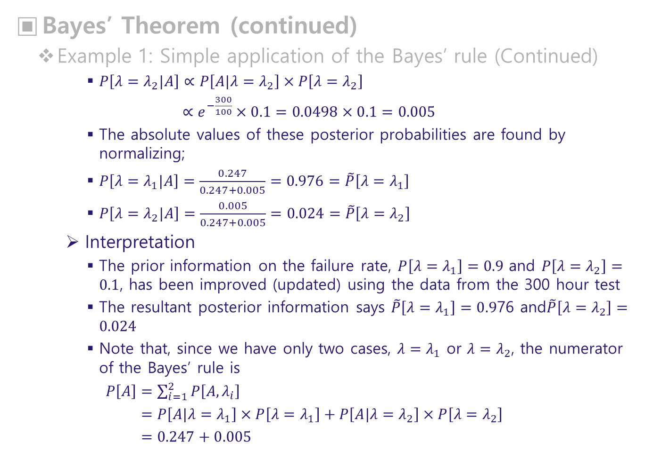
Bayes’ Theorem (continued)
Example 1: Simple application of the Bayes’ rule (Continued)
$P\left[λ=λ_{2}|A\right]∝P\left[A|λ=λ_{2}\right]×P\left[λ=λ_{2}\right]$
$∝e^{−\frac{300}{100}}×0.1=0.0498×0.1=0.005$
The absolute values of these posterior probabilities are found by normalizing;
$P\left[λ=λ_{1}|A\right]=\frac{0.247}{0.247+0.005}=0.976=\tilde{P}\left[λ=λ_{1}\right]$
$P\left[λ=λ_{2}|A\right]=\frac{0.005}{0.247+0.005}=0.024=\tilde{P}\left[λ=λ_{2}\right]$
Interpretation
The prior information on the failure rate, $P\left[λ=λ_{1}\right]=0.9$ and $P\left[λ=λ_{2}\right]=0.1$, has been improved (updated) using the data from the 300 hour test
The resultant posterior information says $\tilde{P}\left[λ=λ_{1}\right]=0.9$76 and$\tilde{P}\left[λ=λ_{2}\right]=0.024$
Note that, since we have only two cases, $λ=λ_{1}$ or $λ=λ_{2}$, the numerator of the Bayes’ rule is
$P\left[A\right]=\sum_{i=1}^{2}{P\left[A,λ_{i}\right]}$
$=P\left[A|λ=λ_{1}\right]×P\left[λ=λ_{1}\right]+P\left[A|λ=λ_{2}\right]×P\left[λ=λ_{2}\right]$
$=0.247+0.005$

Slide 15
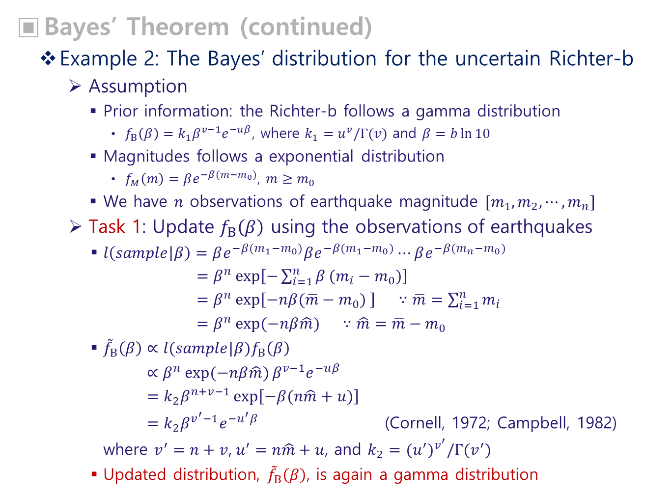
Bayes’ Theorem (continued)
Example 2: The Bayes’ distribution for the uncertain Richter-b
Assumption
Prior information: the Richter-b follows a gamma distribution
$f_{Β}\left(β\right)=k_{1}β^{v−1}e^{−uβ}$, where $k_{1}=u^{v}/Γ(v)$ and $β=b\ln{10}$
Magnitudes follows a exponential distribution
$f_{M}\left(m\right)=βe^{−β(m−m_{0})}$, $m≥m_{0}$
We have $n$ observations of earthquake magnitude $[m_{1},m_{2},⋯,m_{n}]$
Task 1: Update $f_{Β}\left(β\right)$ using the observations of earthquakes
$l\left(sample | β\right)=βe^{−β(m_{1}−m_{0})}βe^{−β(m_{1}−m_{0})}⋯βe^{−β(m_{n}−m_{0})}$
$=β^{n}\exp\left[−\sum_{i=1}^{n}{β}(m_{i}−m_{0})\right]$
$=β^{n}\exp\left[−nβ(\overline{m}−m_{0}) \right] ∵\overline{m}=\sum_{i=1}^{n}{m_{i}}$
$=β^{n}\exp{(−nβ\hat{m}) } ∵\hat{m}=\overline{m}−m_{0}$
${\tilde{f}}_{Β}\left(β\right)∝l(sample|β)f_{Β}\left(β\right)$
$∝β^{n}\exp{(−nβ\hat{m})}β^{v−1}e^{−uβ}$
$=k_{2}β^{n+v−1}\exp\left[−β(n\hat{m}+u)\right]$
$=k_{2}β^{v^{′}−1}e^{−u^{′}β}$ (Cornell, 1972; Campbell, 1982)
where $v^{′}=n+v$, $u^{′}=n\hat{m}+u$, and $k_{2}={{(u}^{′})}^{v^{′}}/Γ(v^{′})$
Updated distribution, ${\tilde{f}}_{Β}\left(β\right)$, is again a gamma distribution

Slide 16
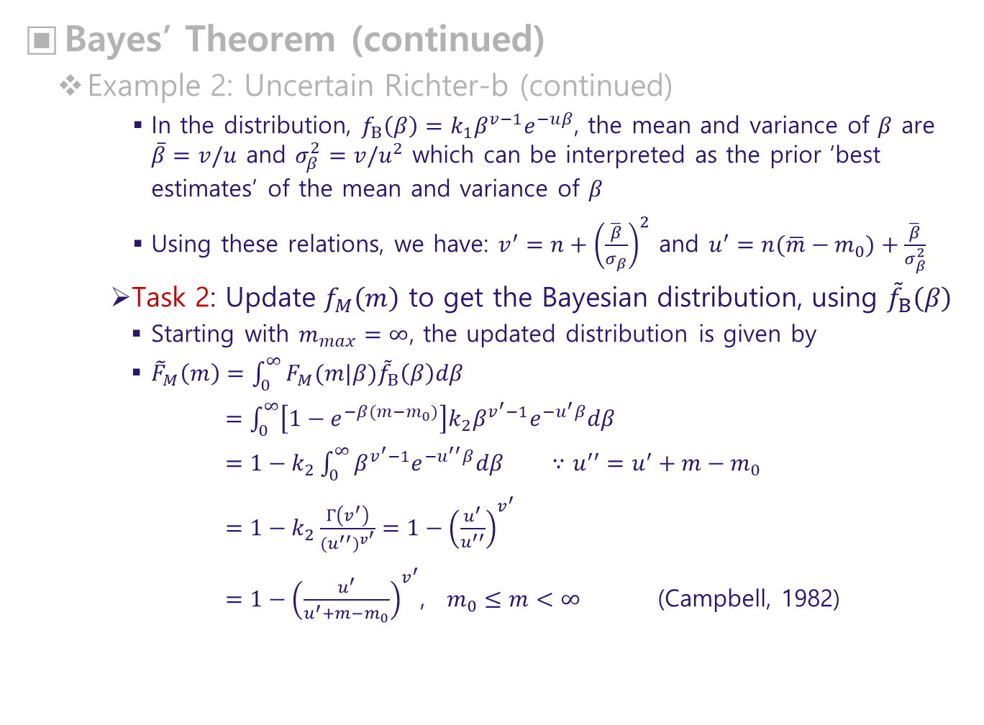
Bayes’ Theorem (continued)
Example 2: Uncertain Richter-b (continued)
In the distribution, $f_{Β}\left(β\right)=k_{1}β^{v−1}e^{−uβ}$, the mean and variance of $β$ are $\overline{β}=v/u$ and $σ_{β}^{2}=v/u^{2}$ which can be interpreted as the prior ‘best estimates’ of the mean and variance of $β$
Using these relations, we have: $v^{′}=n+{\left(\frac{\overline{β}}{σ_{β}}\right)}^{2}$ and $u^{′}=n(\overline{m}−m_{0})+\frac{\overline{β}}{σ_{β}^{2}}$
Task 2: Update $f_{M}\left(m\right)$ to get the Bayesian distribution, using ${\tilde{f}}_{Β}\left(β\right)$
Starting with $m_{max}=∞$, the updated distribution is given by
${\tilde{F}}_{M}\left(m\right)=\int_{0}^{∞}{F_{M}(m|β){\tilde{f}}_{Β}\left(β\right)dβ}$
$=\int_{0}^{∞}{\left[1−e^{−β(m−m_{0})}\right]k_{2}β^{v^{′}−1}e^{−u^{′}β}dβ}$
$=1−k_{2}\int_{0}^{∞}{β^{v^{′}−1}e^{−u^{′′}β}dβ}$ $∵u^{′′}=u^{′}+m−m_{0}$
$=1−k_{2}\frac{Γ\left(v^{′}\right)}{{{(u}^{′′})}^{v^{′}}}=1−{\left(\frac{u^{′}}{u^{′′}}\right)}^{v^{′}}$
$=1−{\left(\frac{u^{′}}{u^{′}+m−m_{0}}\right)}^{v^{′}}$, $m_{0}≤m<∞$ (Campbell, 1982)

Slide 17
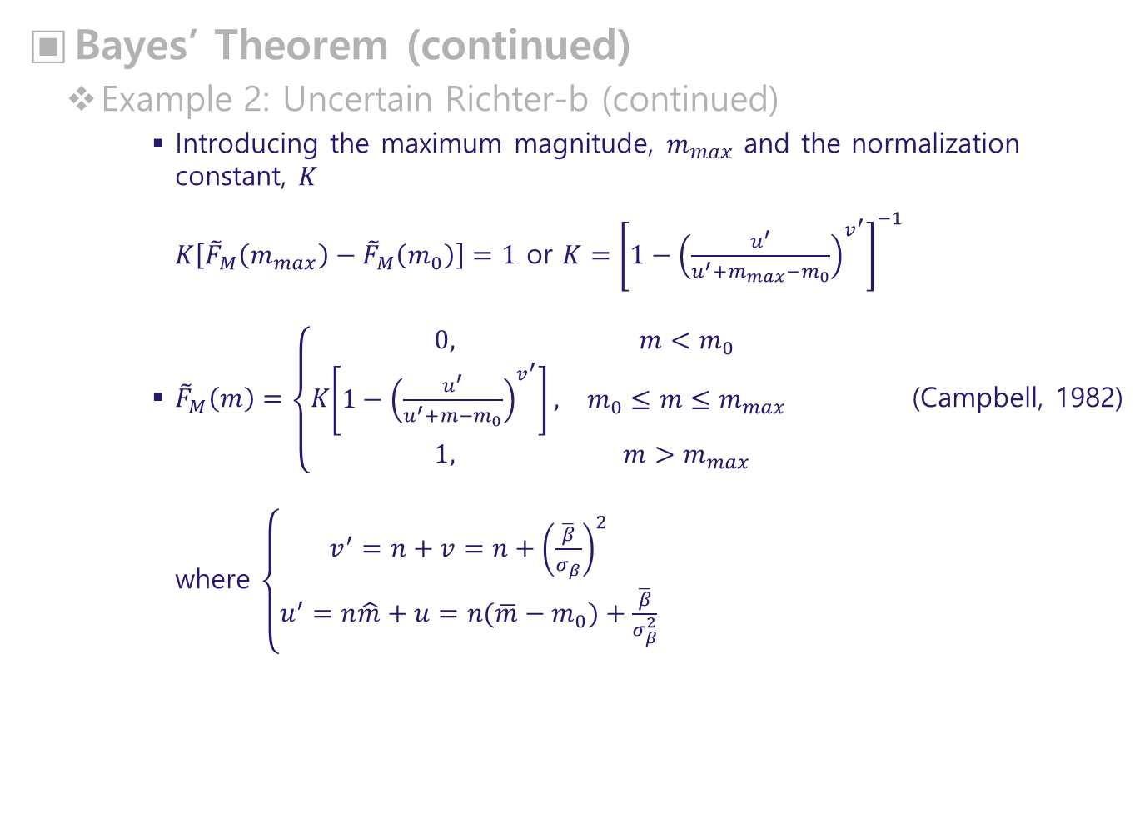
Bayes’ Theorem (continued)
Example 2: Uncertain Richter-b (continued)
Introducing the maximum magnitude, $m_{max}$ and the normalization constant, $K$
$K\left[{\tilde{F}}_{M}\left(m_{max}\right)−{\tilde{F}}_{M}\left(m_{0}\right)\right]=1$ or $K={\left[1−{\left(\frac{u^{′}}{u^{′}+m_{max}−m_{0}}\right)}^{v^{′}}\right]}^{−1}$
${\tilde{F}}_{M}\left(m\right)=\left\{K\begin{matrix}0, & m<m_{0} \\ \left[1−{\left(\frac{u^{′}}{u^{′}+m−m_{0}}\right)}^{v^{′}}\right], & m_{0}≤m≤m_{max} \\ 1, & m>m_{max}\end{matrix}\right.$ (Campbell, 1982)
where $\left\{\begin{matrix}v^{′}=n+v=n+{\left(\frac{\overline{β}}{σ_{β}}\right)}^{2} \\ u^{′}=n\hat{m}+u=n(\overline{m}−m_{0})+\frac{\overline{β}}{σ_{β}^{2}}\end{matrix}\right.$

Slide 18
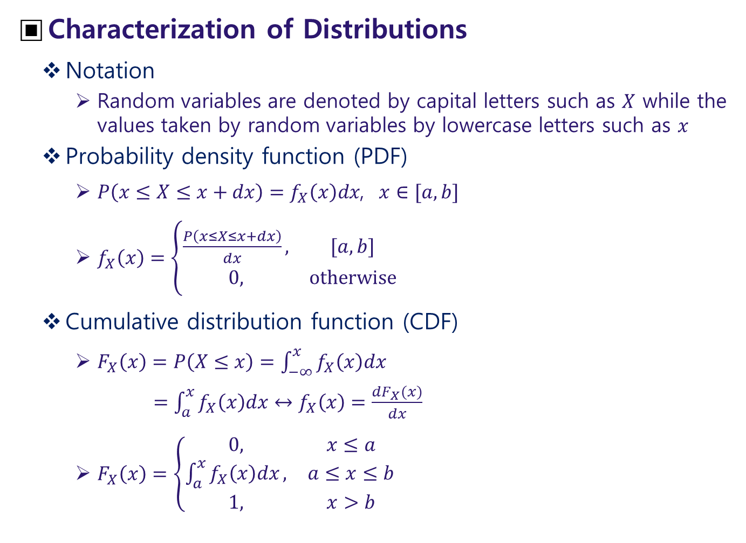
Characterization of Distributions
Notation
Random variables are denoted by capital letters such as $X$ while the values taken by random variables by lowercase letters such as $x$
Probability density function (PDF)
$P\left(x≤X≤x+dx\right)=f_{X}\left(x\right)dx$, $x∈[a,b]$
$f_{X}\left(x\right)=\left\{\begin{matrix}\frac{P\left(x≤X≤x+dx\right)}{dx}, & [a,b] \\ 0, & otherwise\end{matrix}\right.$
Cumulative distribution function (CDF)
$F_{X}\left(x\right)=P\left(X≤x\right)=\int_{−∞}^{x}{f_{X}\left(x\right)dx}$
$=\int_{a}^{x}{f_{X}\left(x\right)dx}↔f_{X}\left(x\right)=\frac{dF_{X}(x)}{dx}$
$F_{X}\left(x\right)=\left\{\begin{matrix}0, & x≤a \\ \int_{a}^{x}{f_{X}\left(x\right)dx}, & a≤x≤b \\ 1, & x>b\end{matrix} \right.$

Slide 19
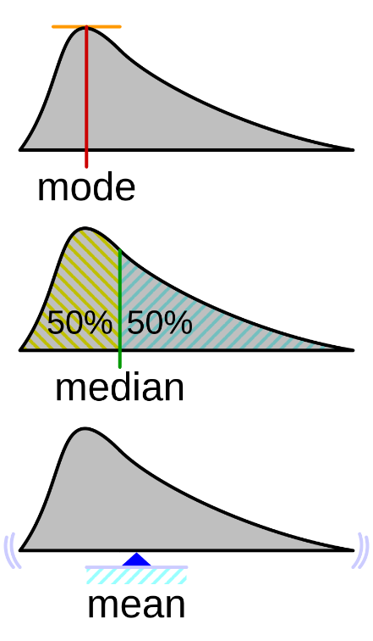
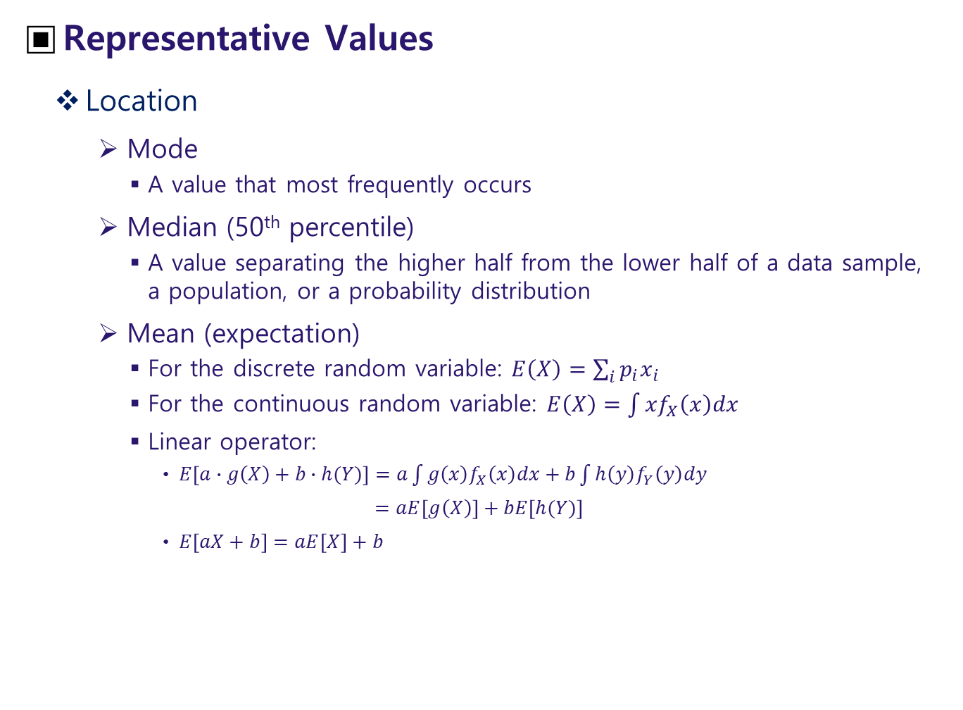
Representative Values
Location
Mode
A value that most frequently occurs
Median (50th percentile)
A value separating the higher half from the lower half of a data sample, a population, or a probability distribution
Mean (expectation)
For the discrete random variable: $E\left(X\right)=\sum_{i}{p_{i}x_{i}}$
For the continuous random variable: $E\left(X\right)=\int{{xf}_{X}\left(x\right)dx}$
Linear operator:
$E\left[a∙g\left(X\right)+b∙h(Y)\right]=a\int{g\left(x\right)f_{X}\left(x\right)dx}+b\int{h\left(y\right)f_{Y}\left(y\right)dy}$
$=aE\left[g\left(X\right)\right]+bE\left[h(Y)\right]$
$E\left[aX+b\right]=aE\left[X\right]+b$
<from Wikipedia>

Slide 20
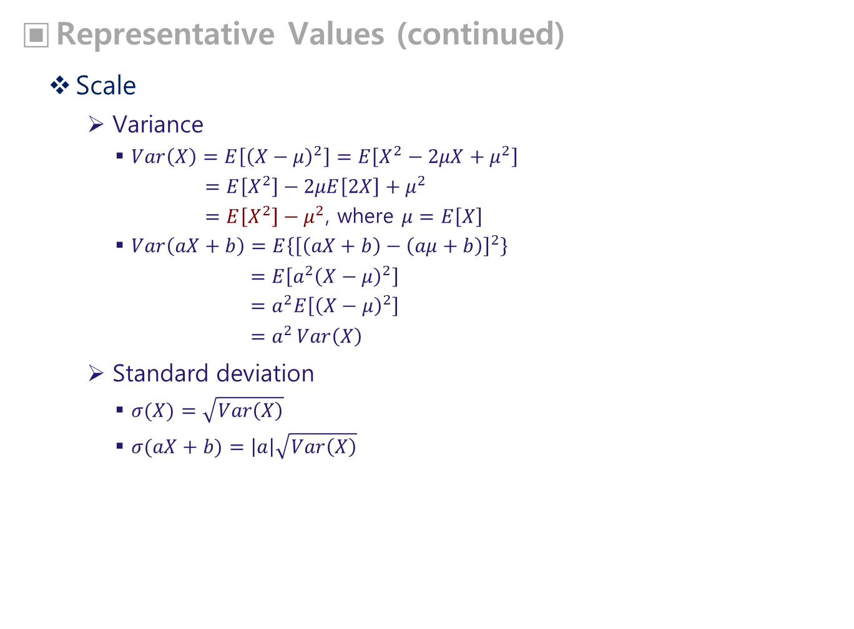
Representative Values (continued)
Scale
Variance
$Var\left(X\right)=E\left[{\left(X−μ\right)}^{2}\right]=E\left[X^{2}−2μX+μ^{2}\right]$
$=E\left[X^{2}\right]−2μE\left[2X\right]+μ^{2}$
$=E\left[X^{2}\right]−μ^{2}$, where $μ=E\left[X\right]$
$Var\left(aX+b\right)=E\left\{{\left[\left(aX+b\right)−\left(aμ+b\right)\right]}^{2}\right\}$
$=E\left[{a^{2}\left(X−μ\right)}^{2}\right]$
$=a^{2}E\left[{\left(X−μ\right)}^{2}\right]$
$=a^{2 }Var\left(X\right)$
Standard deviation
$σ(X)=\sqrt{Var\left(X\right)}$
$σ(aX+b)=\left|a\right|\sqrt{Var\left(X\right)}$

Slide 21
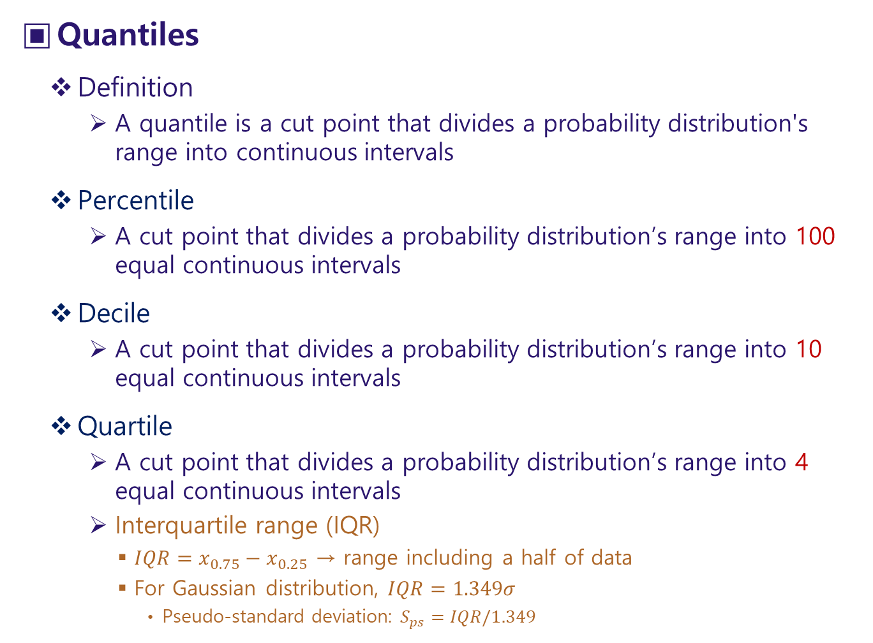
Quantiles
Definition
A quantile is a cut point that divides a probability distribution's range into continuous intervals
Percentile
A cut point that divides a probability distribution’s range into 100 equal continuous intervals
Decile
A cut point that divides a probability distribution’s range into 10 equal continuous intervals
Quartile
A cut point that divides a probability distribution’s range into 4 equal continuous intervals
Interquartile range (IQR)
$IQR=x_{0.75}−x_{0.25}$ → range including a half of data
For Gaussian distribution, $IQR=1.349σ$
Pseudo-standard deviation: $S_{ps}=IQR/1.349$

Slide 22
Resistance & Robustness
Resistance
Degree of tolerance of a statistical technique (an estimator or a statistical test) to the presence of outliers
Ex: median has the maximum resistance of 0.5
Robustness
Insensitivity with regard to an underlying assumed probability model
Ex: residuals are assumed to follow a Gaussian or a uniform distribution with zero mean

Slide 23
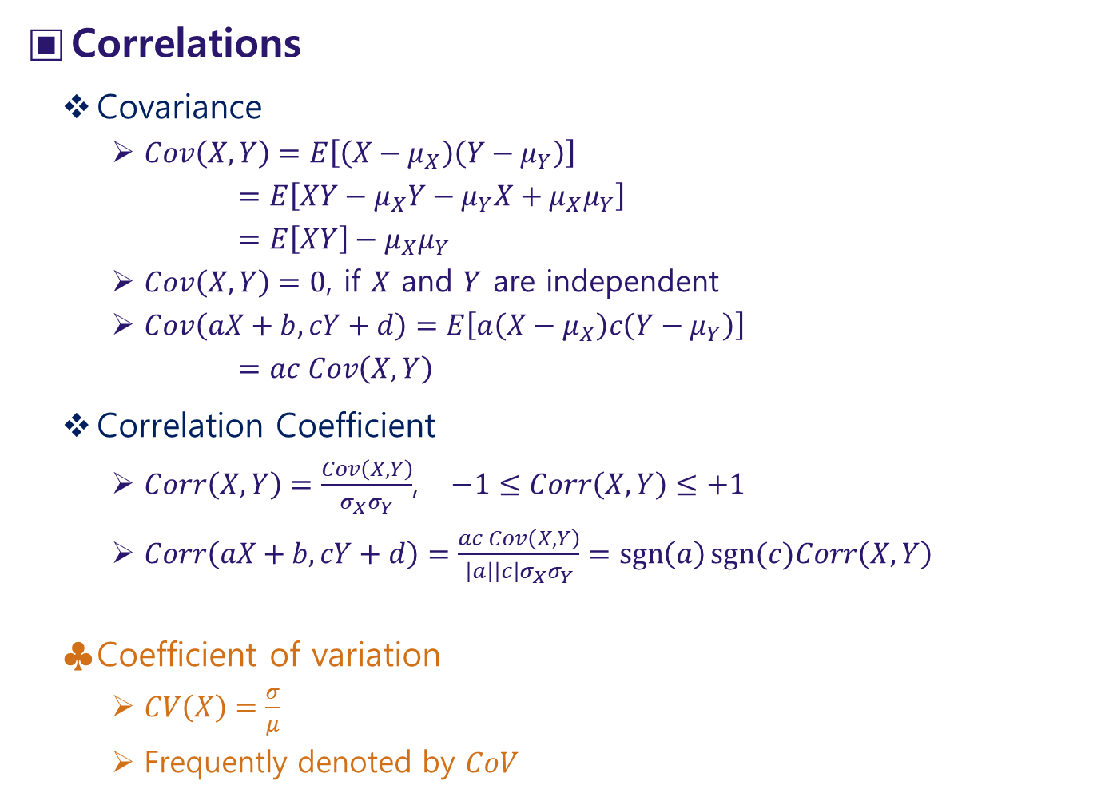
Correlations
Covariance
$Cov\left(X,Y\right)=E\left[\left(X−μ_{X}\right)\left(Y−μ_{Y}\right)\right]$
$=E\left[XY−μ_{X}Y−μ_{Y}X+μ_{X}μ_{Y}\right]$
$=E\left[XY\right]−μ_{X}μ_{Y}$
$Cov\left(X,Y\right)=0$, if $X$ and $Y$ are independent
$Cov\left(aX+b,cY+d\right)=E\left[a\left(X−μ_{X}\right)c\left(Y−μ_{Y}\right)\right]$
$=ac Cov\left(X,Y\right)$
Correlation Coefficient
$Corr\left(X,Y\right)=\frac{Cov\left(X,Y\right)}{σ_{X}σ_{Y}}$, $−1≤Corr\left(X,Y\right)≤+1$
$Corr\left(aX+b,cY+d\right)=\frac{ac Cov\left(X,Y\right)}{\left|a\right|\left|c\right|σ_{X}σ_{Y}}=\operatorname{sgn}\left(a\right)sgn⁡(c)Corr\left(X,Y\right)$
Coefficient of variation
$CV\left(X\right)=\frac{σ}{μ}$
Frequently denoted by $CoV$

Slide 24
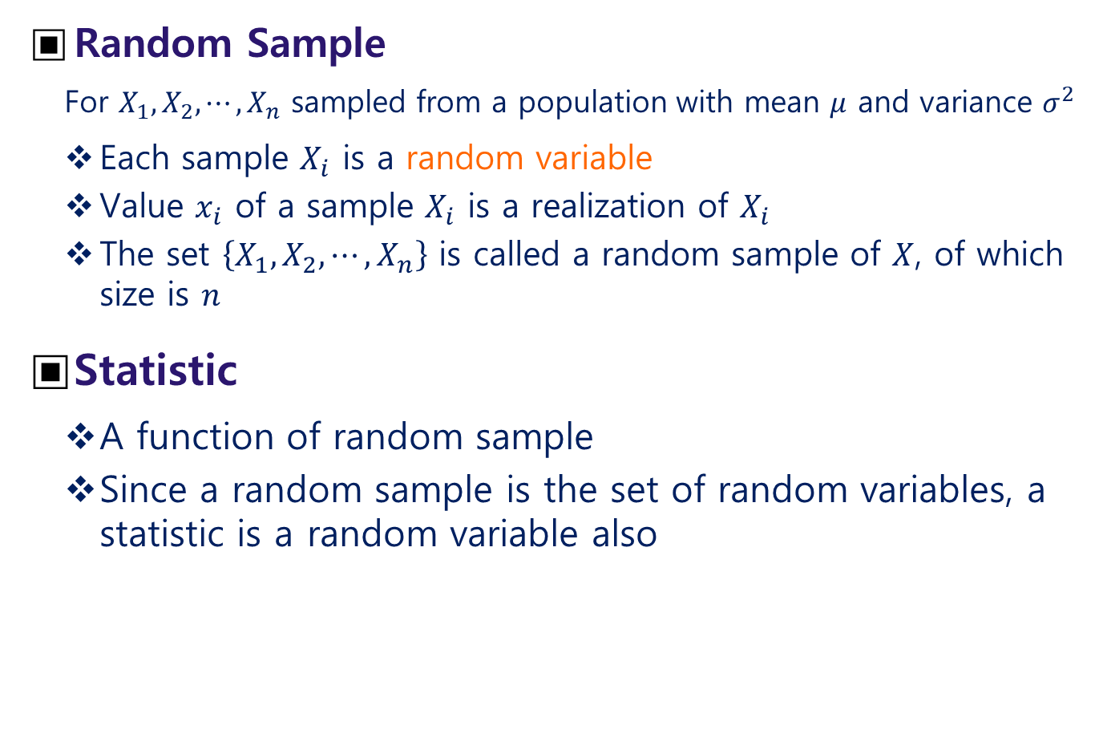
Sample Mean & Variance
Random Sample
For $X_{1},X_{2}, ⋯,X_{n}$ sampled from a population with mean $μ$ and variance $σ^{2}$
Each sample $X_{i}$ is a random variable
Value $x_{i}$ of a sample $X_{i}$ is a realization of $X_{i}$
The set $\left\{X_{1},X_{2}, ⋯,X_{n}\right\}$ is called a random sample of $X$, of which size is $n$
Statistic
A function of random sample
Since a random sample is the set of random variables, a statistic is a random variable also

Slide 25
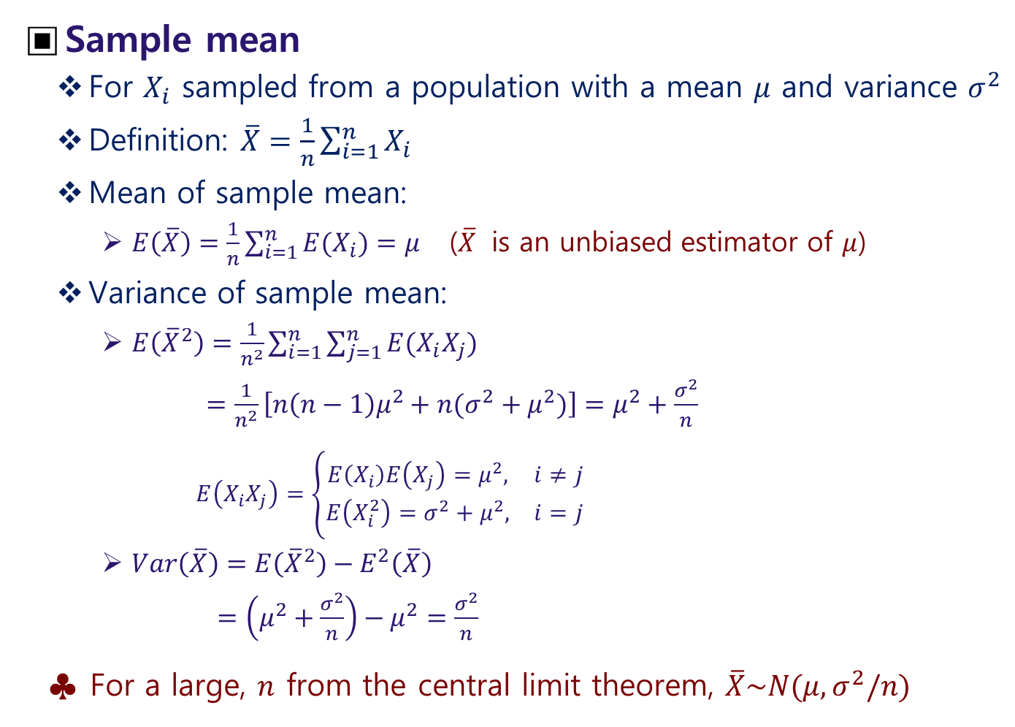
Sample mean
For $X_{i}$ sampled from a population with a mean $μ$ and variance $σ^{2}$
Definition: $\overline{X}=\frac{1}{n}\sum_{i=1}^{n}{X_{i}}$
Mean of sample mean:
$E\left(\overline{X}\right)=\frac{1}{n}\sum_{i=1}^{n}{E(X_{i})}=μ$ ($\overline{X}$ is an unbiased estimator of $μ$)
Variance of sample mean:
$E\left({\overline{X}}^{2}\right)=\frac{1}{n^{2}}\sum_{i=1}^{n}{\sum_{j=1}^{n}{E(X_{i}X_{j})}}$
$=\frac{1}{n^{2}}\left[n\left(n−1\right)μ^{2}+n(σ^{2}+μ^{2})\right]=μ^{2}+\frac{σ^{2}}{n}$
$E\left(X_{i}X_{j}\right)=\left\{\begin{matrix}E\left(X_{i}\right)E\left(X_{j}\right)=μ^{2}, & i≠j \\ E\left(X_{i}^{2}\right)=σ^{2}+μ^{2}, & i=j\end{matrix}\right.$
$Var\left(\overline{X}\right)=E\left({\overline{X}}^{2}\right)−E^{2}\left(\overline{X}\right)$
$=\left(μ^{2}+\frac{σ^{2}}{n}\right)−μ^{2}=\frac{σ^{2}}{n}$
For a large, $n$ from the central limit theorem, $\overline{X}\sim N(μ,σ^{2}/n)$

Slide 26
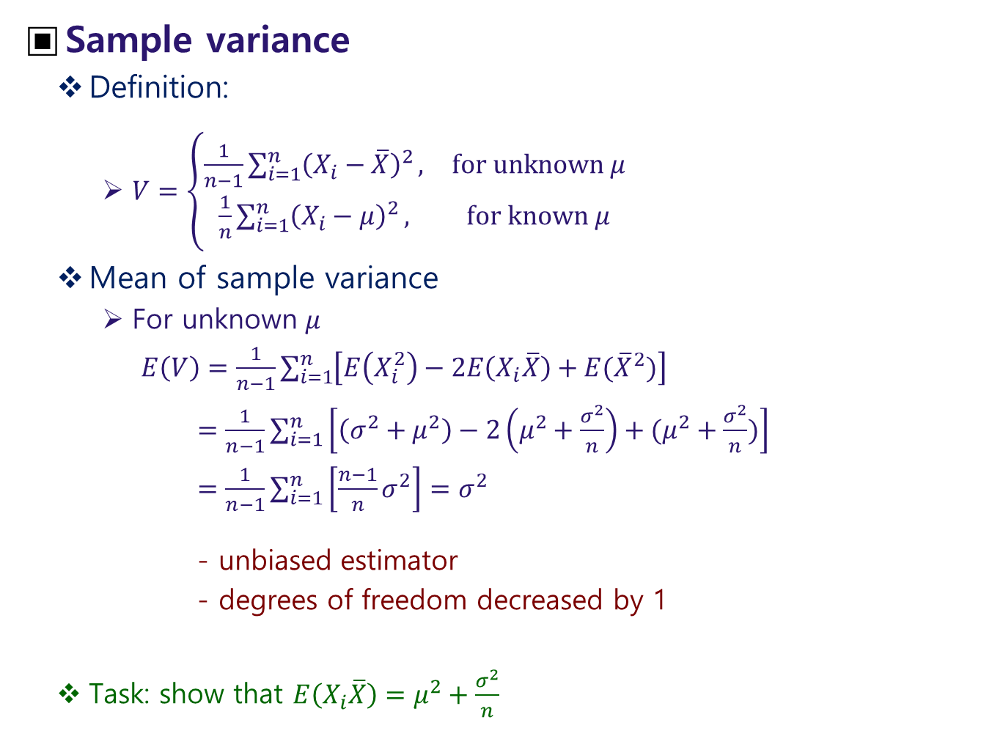
Sample variance
Definition:
$V=\left\{\begin{matrix}\frac{1}{n−1}\sum_{i=1}^{n}{{\left(X_{i}−\overline{X}\right)}^{2}}, & for unknown μ \\ \frac{1}{n}\sum_{i=1}^{n}{{\left(X_{i}−μ\right)}^{2}}, & for known μ\end{matrix}\right.$
Mean of sample variance
For unknown $μ$
$E\left(V\right)=\frac{1}{n−1}\sum_{i=1}^{n}{\left[E\left(X_{i}^{2}\right)−2E\left(X_{i}\overline{X}\right)+E({\overline{X}}^{2})\right]}$
$=\frac{1}{n−1}\sum_{i=1}^{n}{\left[\left(σ^{2}+μ^{2}\right)−2\left(μ^{2}+\frac{σ^{2}}{n}\right)+(μ^{2}+\frac{σ^{2}}{n})\right]}$
$=\frac{1}{n−1}\sum_{i=1}^{n}{\left[\frac{n−1}{n}σ^{2}\right]}=σ^{2}$
- unbiased estimator
- degrees of freedom decreased by 1
Task: show that $E\left(X_{i}\overline{X}\right)=μ^{2}+\frac{σ^{2}}{n}$

Slide 27
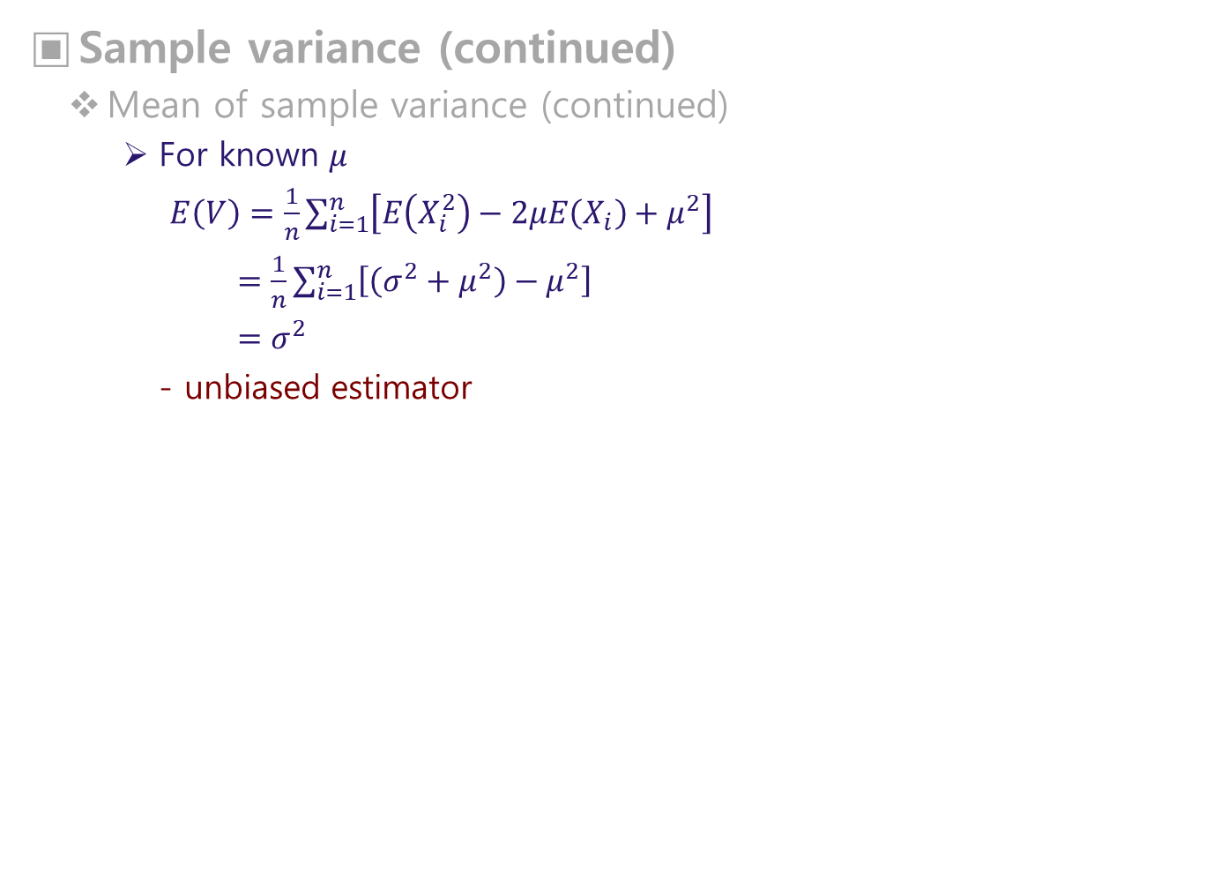
Sample variance (continued)
Mean of sample variance (continued)
For known $μ$
$E\left(V\right)=\frac{1}{n}\sum_{i=1}^{n}{\left[E\left(X_{i}^{2}\right)−2μE\left(X_{i}\right)+μ^{2}\right]}$
$=\frac{1}{n}\sum_{i=1}^{n}{\left[\left(σ^{2}+μ^{2}\right)−μ^{2}\right]}$
$=σ^{2}$
- unbiased estimator

Slide 28
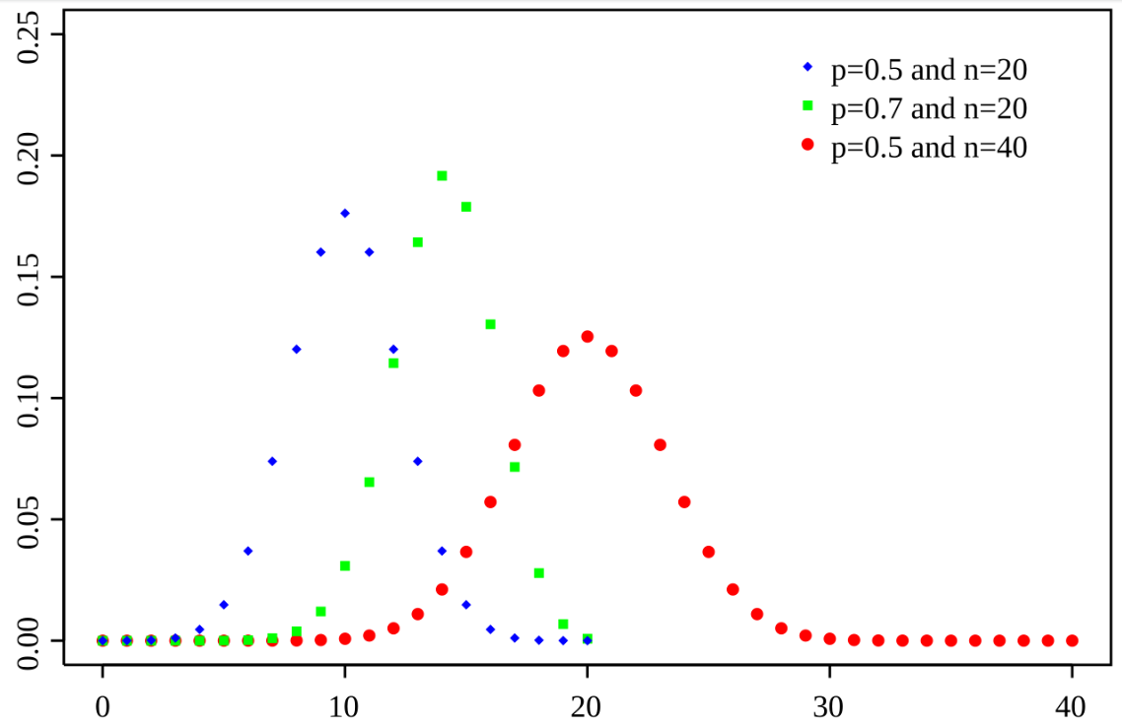
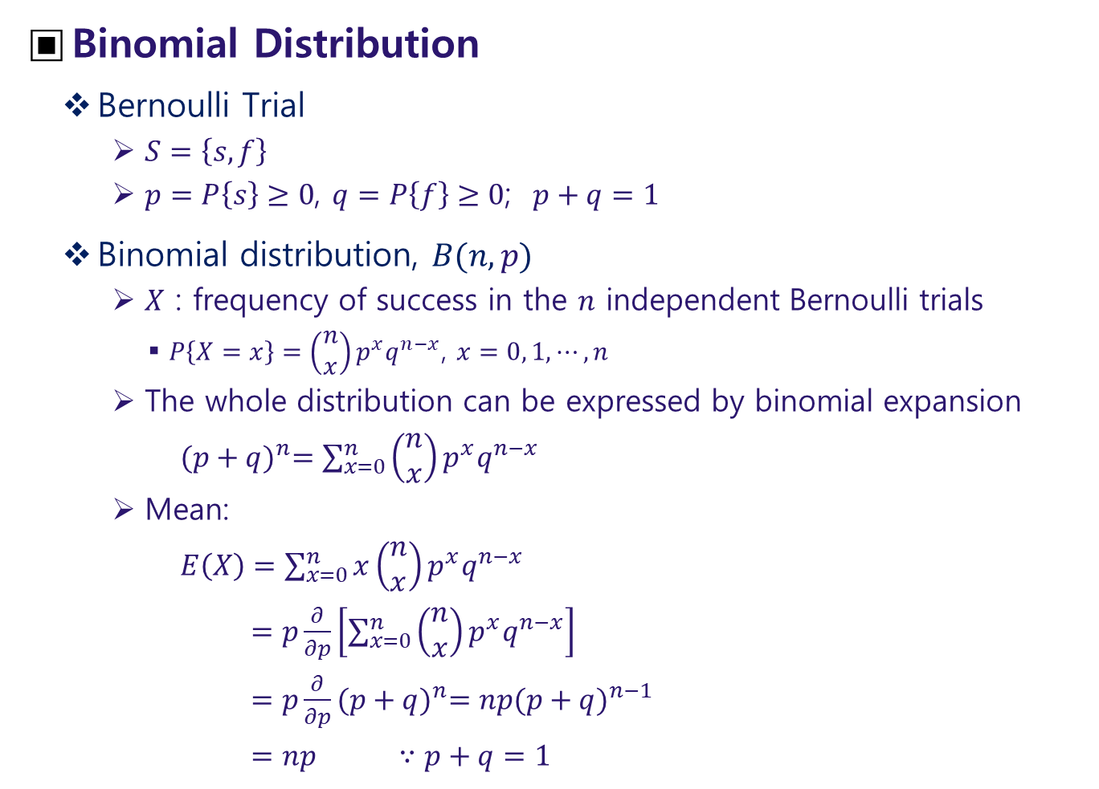
Frequently Used Distributions
Binomial Distribution
Bernoulli Trial
$S=\left\{s, f\right\}$
$p=P\left\{s\right\}≥0$, $q=P\left\{f\right\}≥0$; $p+q=1$
Binomial distribution, $B(n,p)$
$X$ : frequency of success in the $n$ independent Bernoulli trials
$P\left\{X=x\right\}=\left(\begin{matrix}n \\ x\end{matrix}\right)p^{x}q^{n−x}$, $x=0, 1, ⋯, n$
The whole distribution can be expressed by binomial expansion
${(p+q)}^{n}=\sum_{x=0}^{n}{\left(\begin{matrix}n \\ x\end{matrix}\right)p^{x}q^{n−x}}$
Mean:
$E\left(X\right)=\sum_{x=0}^{n}{x\left(\begin{matrix}n \\ x\end{matrix}\right)p^{x}q^{n−x}}$
$=p\frac{∂}{∂p}\left[\sum_{x=0}^{n}{\left(\begin{matrix}n \\ x\end{matrix}\right)p^{x}q^{n−x}}\right]$
$=p\frac{∂}{∂p}{(p+q)}^{n}=np{(p+q)}^{n−1}$
$=np$ $∵p+q=1$
<from Wikipedia>

Slide 29
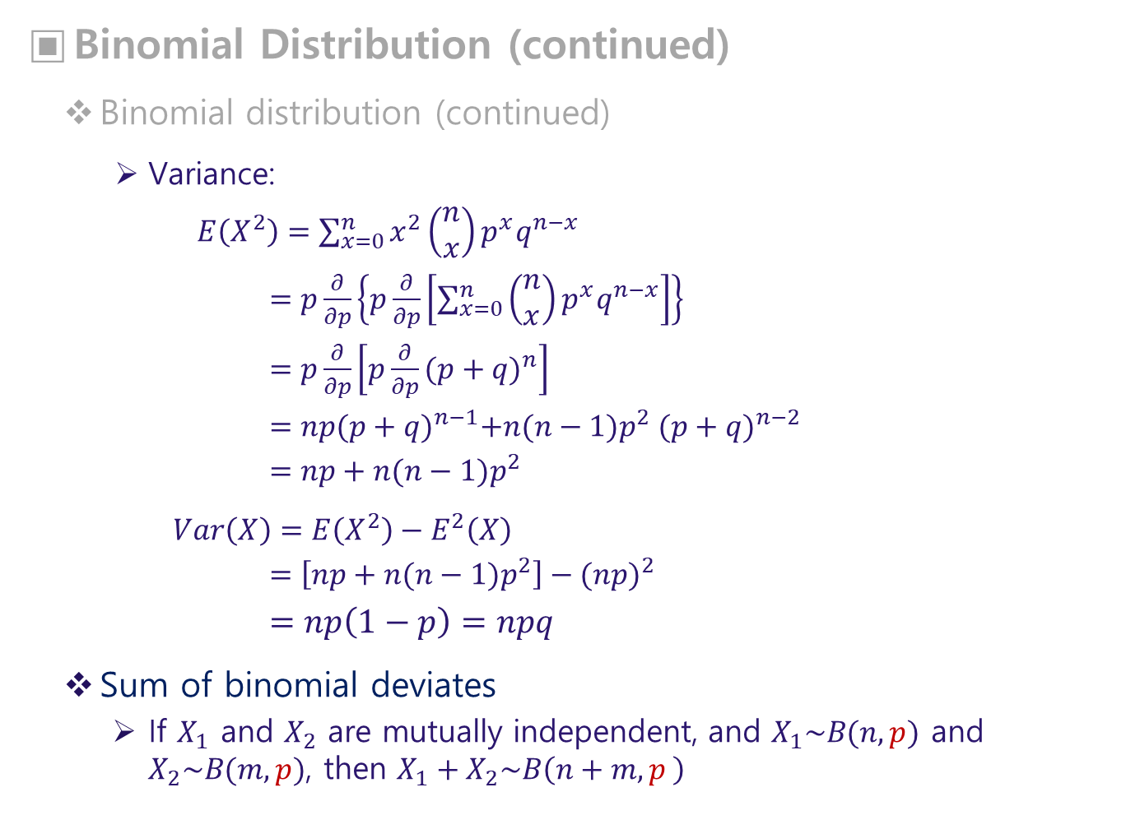
Binomial Distribution (continued)
Binomial distribution (continued)
Variance:
$E\left(X^{2}\right)=\sum_{x=0}^{n}{x^{2}\left(\begin{matrix}n \\ x\end{matrix}\right)p^{x}q^{n−x}}$
$=p\frac{∂}{∂p}\left\{p\frac{∂}{∂p}\left[\sum_{x=0}^{n}{\left(\begin{matrix}n \\ x\end{matrix}\right)p^{x}q^{n−x}}\right]\right\}$
$=p\frac{∂}{∂p}\left[p\frac{∂}{∂p}{(p+q)}^{n}\right]$
$=np{(p+q)}^{n−1}+n(n−1)p^{2} {(p+q)}^{n−2}$
$=np+n(n−1)p^{2}$
$Var\left(X\right)=E\left(X^{2}\right)−E^{2}\left(X\right)$
$=\left[np+n(n−1)p^{2}\right]−{(np)}^{2}$
$=np\left(1−p\right)=npq$
Sum of binomial deviates
If $X_{1}$ and $X_{2}$ are mutually independent, and $X_{1}\sim B(n,p)$ and $X_{2}\sim B(m,p)$, then $X_{1}+X_{2}\sim B\left(n+m,p \right)$

Slide 30
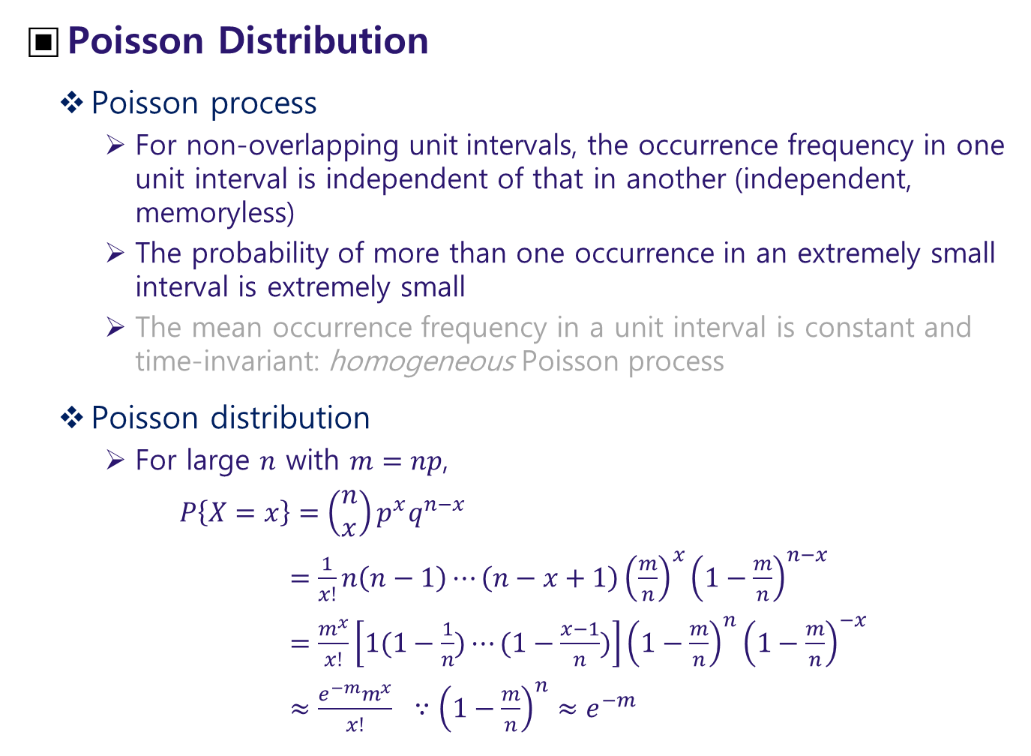
Poisson Distribution
Poisson process
For non-overlapping unit intervals, the occurrence frequency in one unit interval is independent of that in another (independent, memoryless)
The probability of more than one occurrence in an extremely small interval is extremely small
The mean occurrence frequency in a unit interval is constant and time-invariant: homogeneous Poisson process
Poisson distribution
For large $n$ with $m=np$,
$P\left\{X=x\right\}=\left(\begin{matrix}n \\ x\end{matrix}\right)p^{x}q^{n−x}$
$=\frac{1}{x!}n\left(n−1\right)⋯\left(n−x+1\right){\left(\frac{m}{n}\right)}^{x}{\left(1−\frac{m}{n}\right)}^{n−x}$
$=\frac{m^{x}}{x!}\left[1(1−\frac{1}{n})⋯(1−\frac{x−1}{n})\right]{\left(1−\frac{m}{n}\right)}^{n}{\left(1−\frac{m}{n}\right)}^{−x}$
$≈\frac{e^{−m}m^{x}}{x!} ∵{\left(1−\frac{m}{n}\right)}^{n}≈e^{−m}$

Slide 31
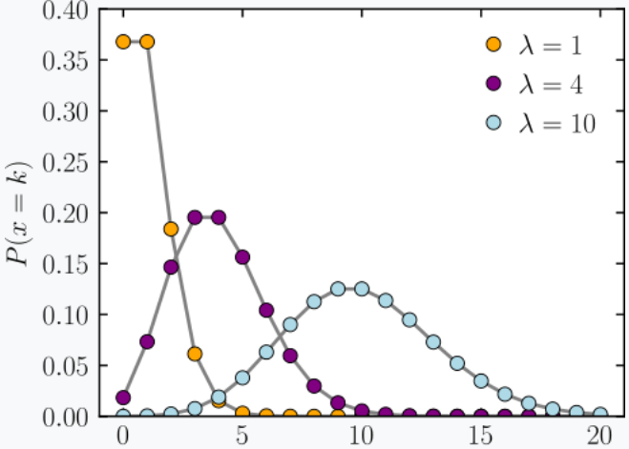
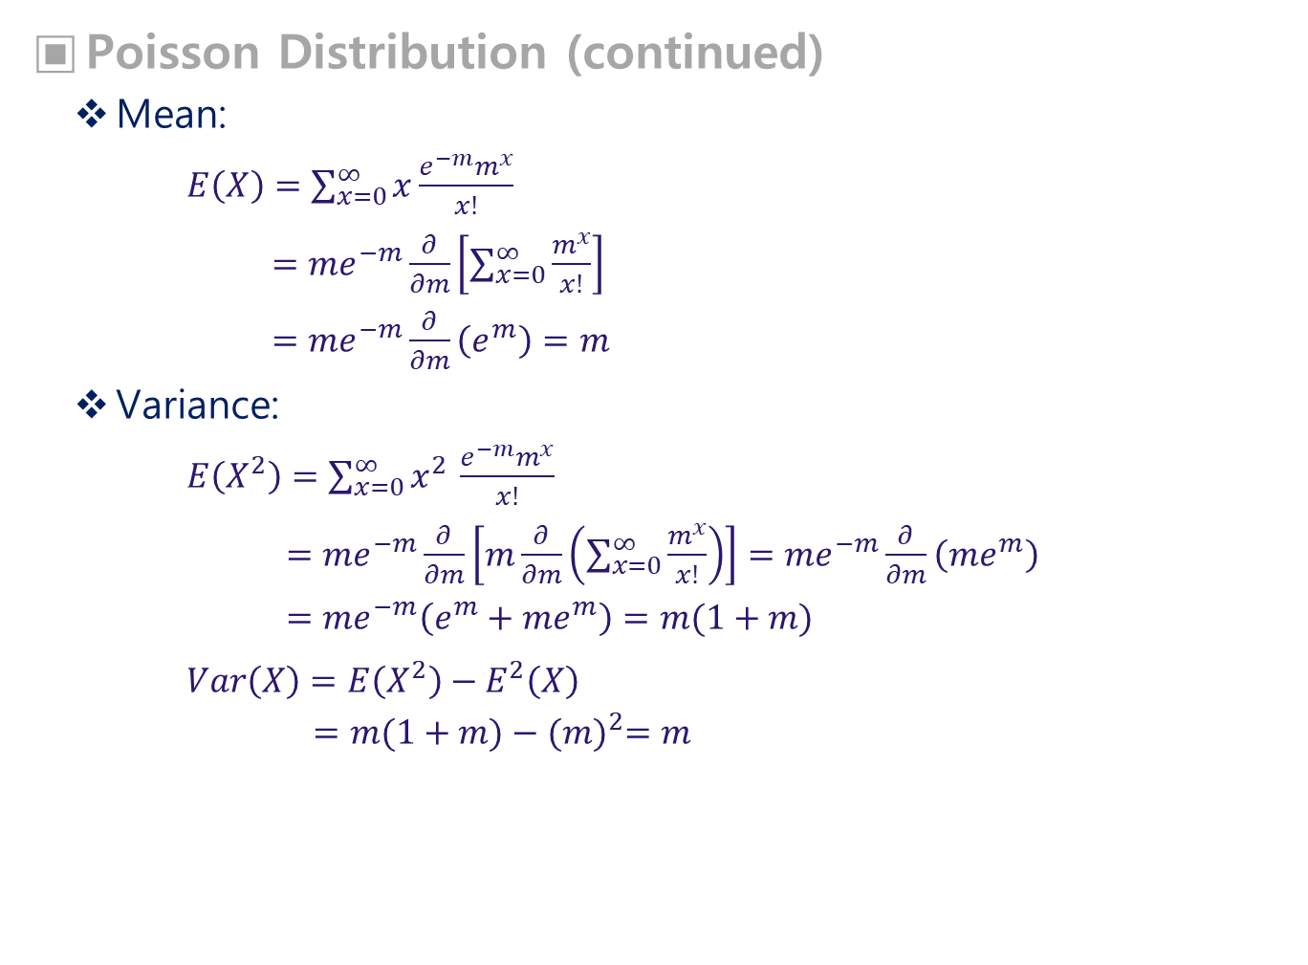

Poisson Distribution (continued)
Mean:
$E\left(X\right)=\sum_{x=0}^{∞}{x\frac{e^{−m}m^{x}}{x!}}$
$=me^{−m}\frac{∂}{∂m}\left[\sum_{x=0}^{∞}{\frac{m^{x}}{x!}}\right]$
$=me^{−m}\frac{∂}{∂m}\left(e^{m}\right)=m$
Variance:
$E\left(X^{2}\right)=\sum_{x=0}^{∞}{x^{2 }\frac{e^{−m}m^{x}}{x!}}$
$=me^{−m}\frac{∂}{∂m}\left[m\frac{∂}{∂m}\left(\sum_{x=0}^{∞}{\frac{m^{x}}{x!}}\right)\right]=me^{−m}\frac{∂}{∂m}\left({me}^{m}\right)$
$=me^{−m}\left(e^{m}+{me}^{m}\right)=m(1+m)$
$Var\left(X\right)=E\left(X^{2}\right)−E^{2}\left(X\right)$
$=m(1+m)−{(m)}^{2}=m$
<PMF with $λ≡m$, from Wikipedia>

Slide 32
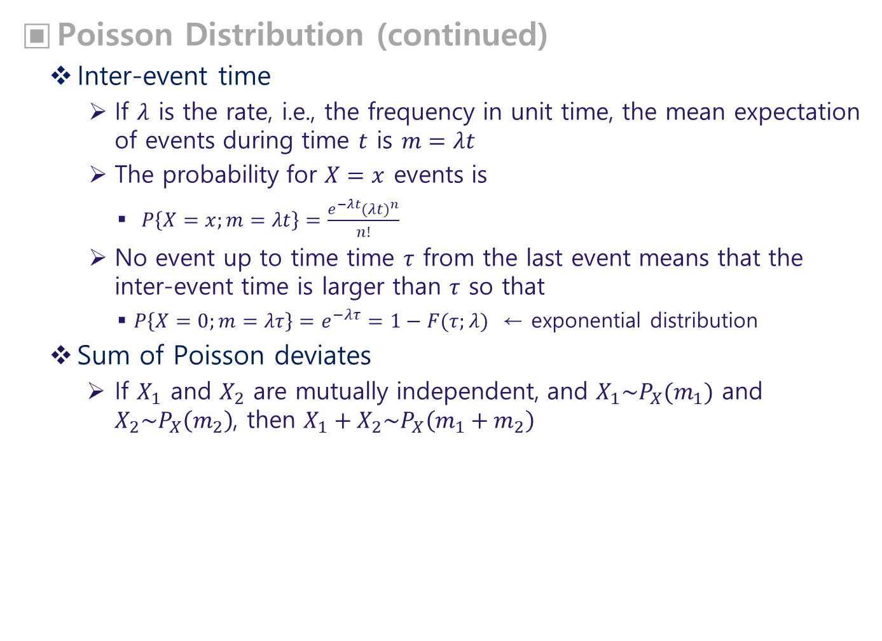
Poisson Distribution (continued)
Inter-event time
If $λ$ is the rate, i.e., the frequency in unit time, the mean expectation of events during time $t$ is $m=λt$
The probability for $X=x$ events is
$P\left\{X=x;m=λt\right\}=\frac{e^{−λt}{(λt)}^{n}}{n!}$
No event up to time time $τ$ from the last event means that the inter-event time is larger than $τ$ so that
$P\left\{X=0;m=λτ\right\}=e^{−λτ}=1−F(τ;λ)$ ← exponential distribution
Sum of Poisson deviates
If $X_{1}$ and $X_{2}$ are mutually independent, and $X_{1}\sim P_{X}(m_{1})$ and $X_{2}\sim P_{X}\left(m_{2}\right)$, then $X_{1}+X_{2}\sim P_{X}\left(m_{1}+m_{2}\right)$

Slide 33
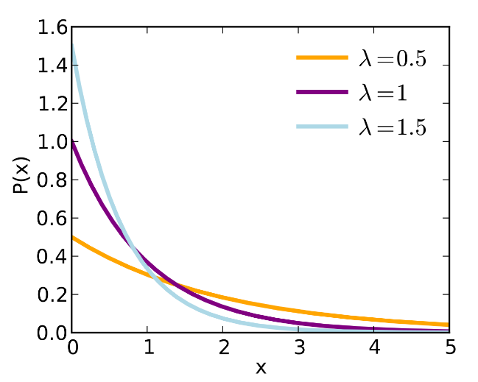
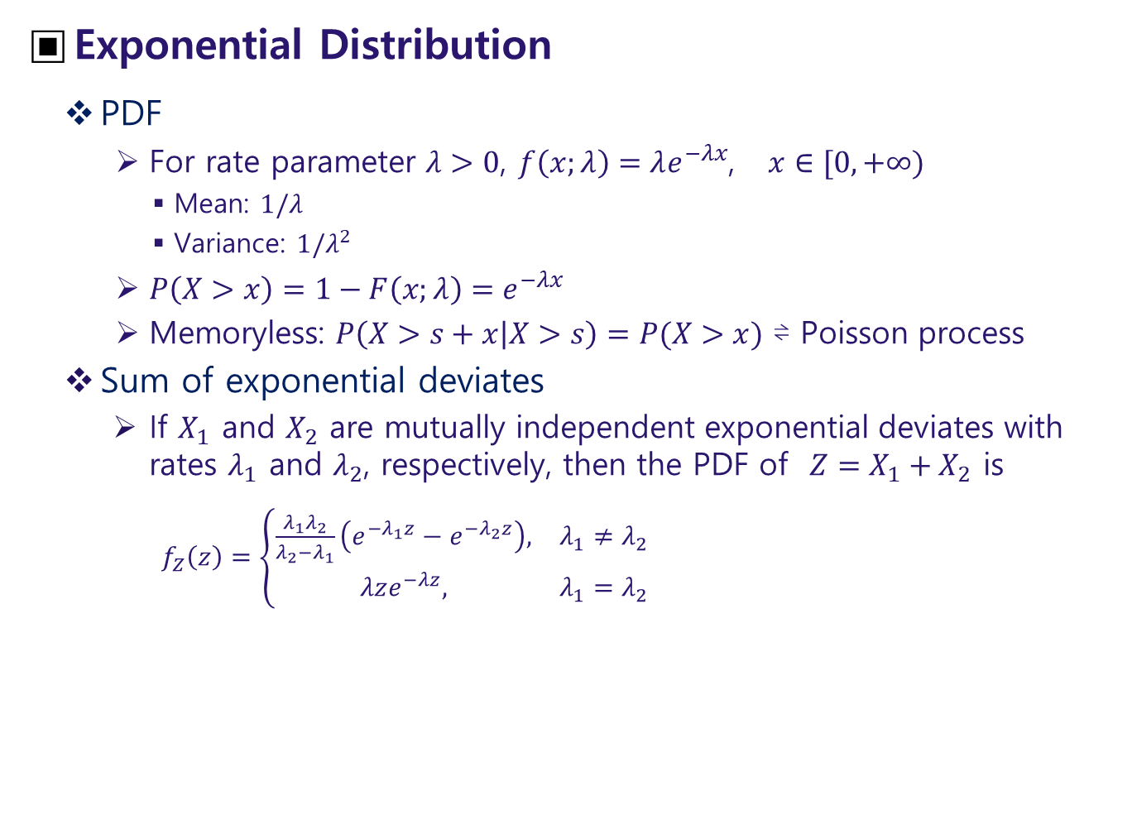
Exponential Distribution
PDF
For rate parameter $λ>0$, $f\left(x;λ\right)=λe^{−λx}$, $x∈[0,+∞)$
Mean: $1/λ$
Variance: $1/λ^{2}$
$P\left(X>x\right)=1−F\left(x;λ\right)=e^{−λx}$
Memoryless: $P\left(X>s+x | X>s\right)=P(X>x)$ ⇌ Poisson process
Sum of exponential deviates
If $X_{1}$ and $X_{2}$ are mutually independent exponential deviates with rates $λ_{1}$ and $λ_{2}$, respectively, then the PDF of $Z=X_{1}+X_{2}$ is
$f_{Z}\left(z\right)=\left\{\begin{matrix}\frac{λ_{1}λ_{2}}{λ_{2}−λ_{1}}\left(e^{−λ_{1}z}−e^{−λ_{2}z}\right), & λ_{1}≠λ_{2} \\ λze^{−λz}, & λ_{1}=λ_{2}\end{matrix}\right.$
<from Wikipedia>

Slide 34
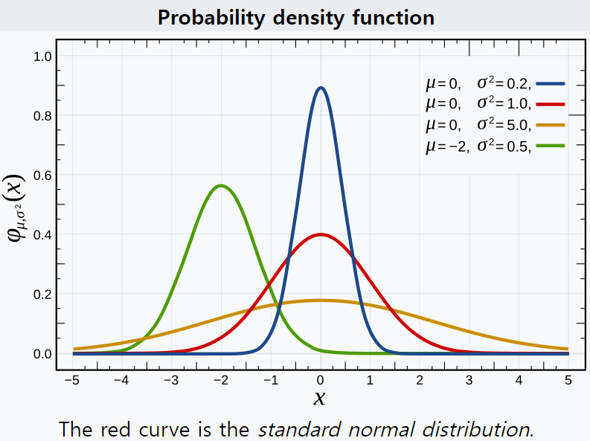
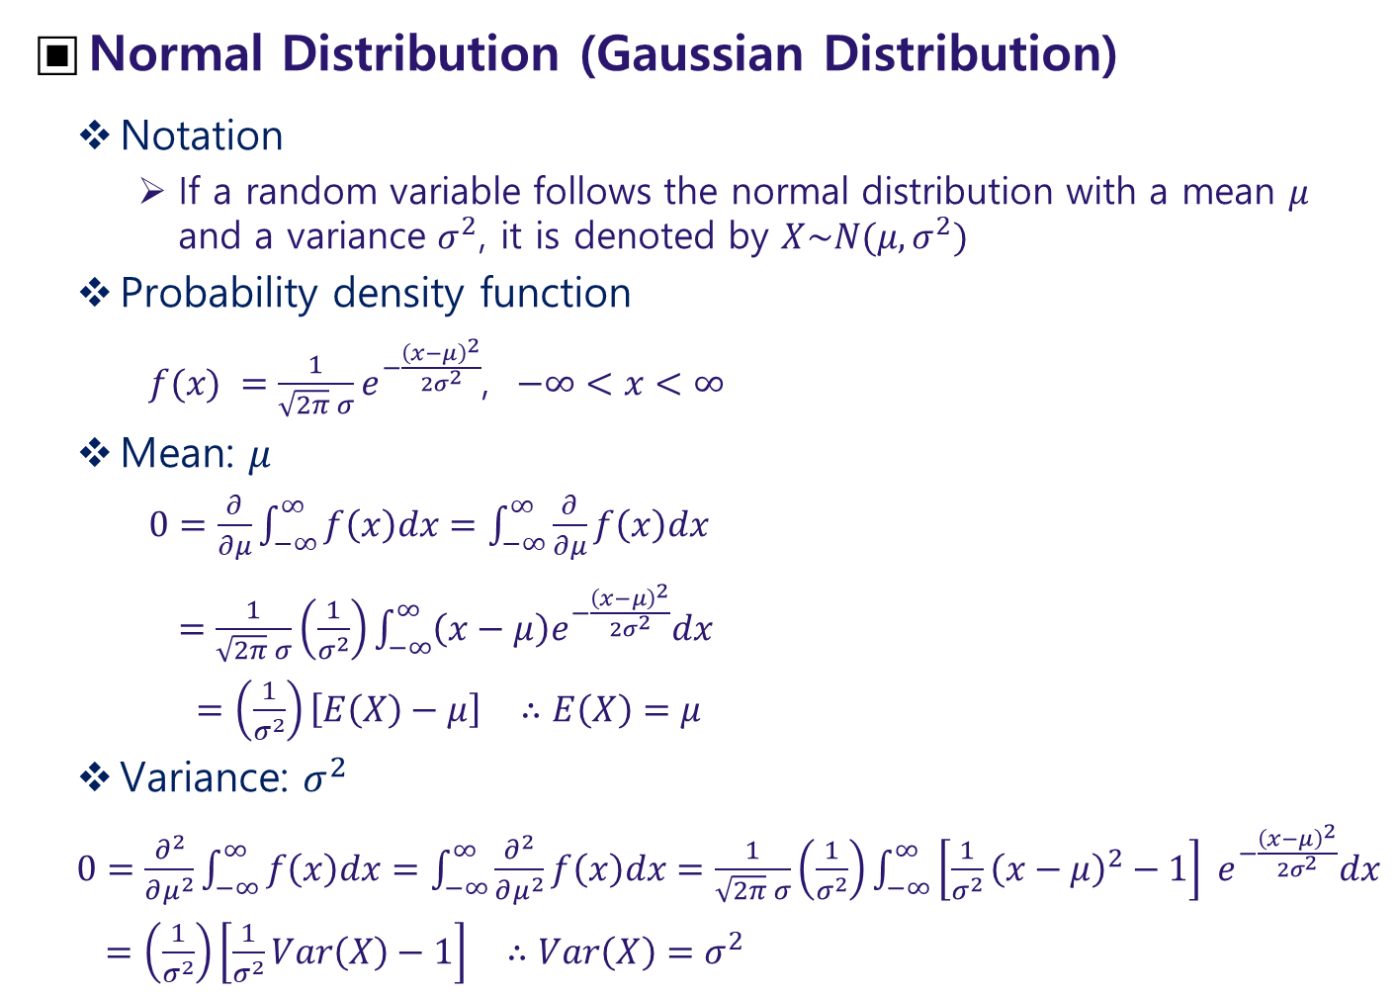
Normal Distribution (Gaussian Distribution)
Notation
If a random variable follows the normal distribution with a mean $μ$ and a variance $σ^{2}$, it is denoted by $X\sim N(μ,σ^{2})$
Probability density function
$f(x) =\frac{1}{\sqrt{2π} σ}e^{−\frac{{\left(x−μ\right)}^{2}}{2σ^{2}}}$, $−∞<x<∞$
Mean: $μ$
$0=\frac{∂}{∂μ}\int_{−∞}^{∞}{f\left(x\right)dx}=\int_{−∞}^{∞}{\frac{∂}{∂μ}f\left(x\right)dx}$
$=\frac{1}{\sqrt{2π} σ}\left(\frac{1}{σ^{2}}\right)\int_{−∞}^{∞}{\left(x−μ\right)e^{−\frac{{\left(x−μ\right)}^{2}}{2σ^{2}}}dx}$
$=\left(\frac{1}{σ^{2}}\right)\left[E\left(X\right)−μ\right]$ $∴E\left(X\right)=μ$
Variance: $σ^{2}$
$0=\frac{∂^{2}}{∂μ^{2}}\int_{−∞}^{∞}{f\left(x\right)dx}=\int_{−∞}^{∞}{\frac{∂^{2}}{∂μ^{2}}f\left(x\right)dx}=\frac{1}{\sqrt{2π} σ}\left(\frac{1}{σ^{2}}\right)\int_{−∞}^{∞}{\left[{\frac{1}{σ^{2}}\left(x−μ\right)}^{2}−1\right] e^{−\frac{{\left(x−μ\right)}^{2}}{2σ^{2}}}dx}$
$=\left(\frac{1}{σ^{2}}\right)\left[\frac{1}{σ^{2}}Var\left(X\right)−1\right]$ $∴Var\left(X\right)=σ^{2}$
<from Wikipedia>

Slide 35
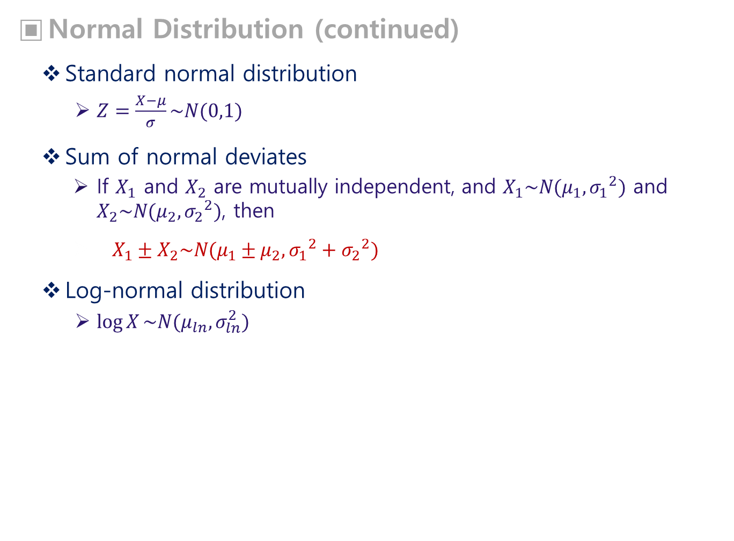
Normal Distribution (continued)
Standard normal distribution
$Z=\frac{X−μ}{σ}\sim N(0,1)$
Sum of normal deviates
If $X_{1}$ and $X_{2}$ are mutually independent, and $X_{1}\sim N(μ_{1},{σ_{1}}^{2})$ and $X_{2}\sim N(μ_{2},{σ_{2}}^{2})$, then
$X_{1}±X_{2}\sim N(μ_{1}±μ_{2},{σ_{1}}^{2}+{σ_{2}}^{2})$
Log-normal distribution
$\log{X}\sim N(μ_{ln},σ_{ln}^{2})$

Slide 36
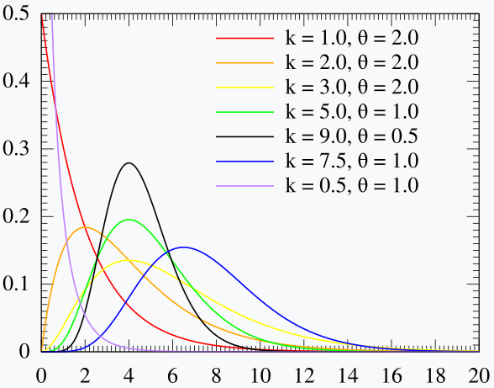
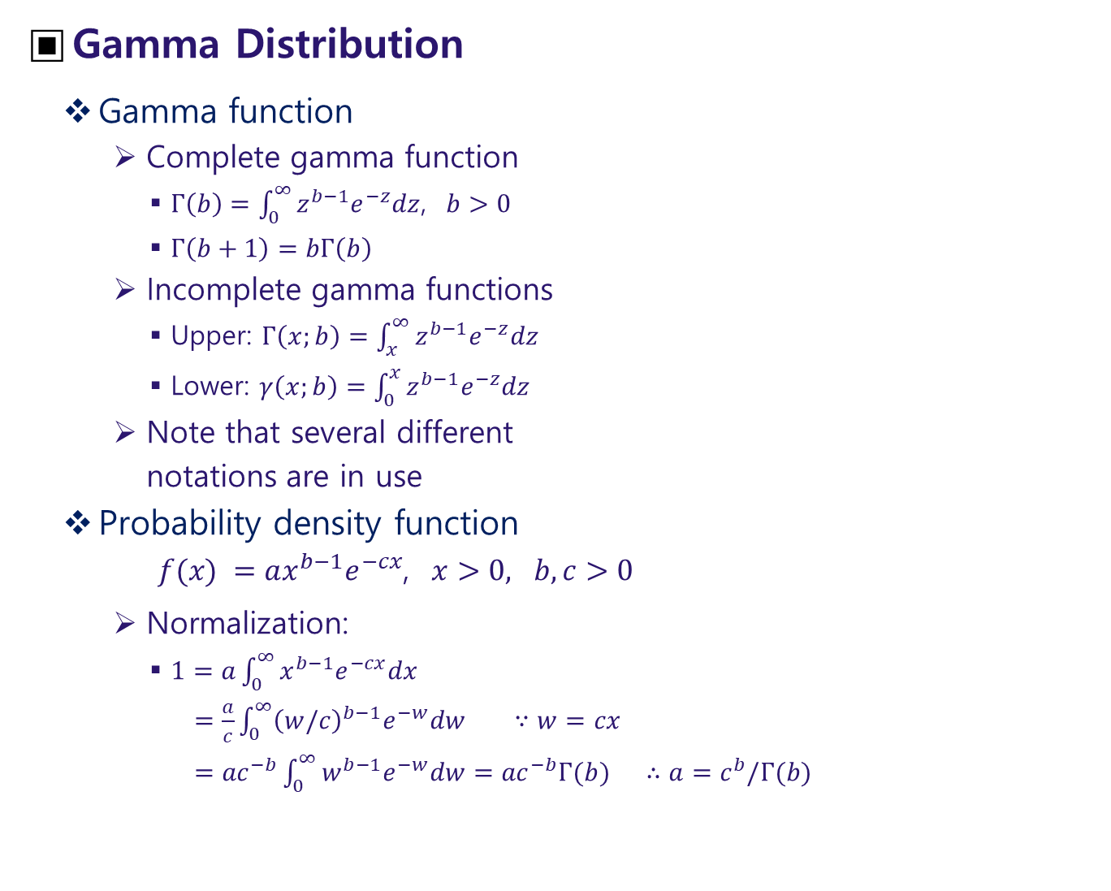
Gamma Distribution
Gamma function
Complete gamma function
$Γ\left(b\right)=\int_{0}^{∞}{z^{b−1}e^{−z}dz}$, $b>0$
$Γ\left(b+1\right)=bΓ\left(b\right)$
Incomplete gamma functions
Upper: $Γ\left(x;b\right)=\int_{x}^{∞}{z^{b−1}e^{−z}dz}$
Lower: $γ\left(x;b\right)=\int_{0}^{x}{z^{b−1}e^{−z}dz}$
Note that several different
notations are in use
Probability density function
$f(x) =ax^{b−1}e^{−cx}$, $x>0, b,c>0$
Normalization:
$1=a\int_{0}^{∞}{x^{b−1}e^{−cx}dx}$
$=\frac{a}{c}\int_{0}^{∞}{{\left(w/c\right)}^{b−1}e^{−w}dw}$ $∵w=cx$
$={ac}^{−b}\int_{0}^{∞}{w^{b−1}e^{−w}dw}={ac}^{−b}Γ(b)$ $∴a=c^{b}/Γ(b)$
<Probability density function, $k≡b, θ≡1/c$>
<from Wikipedia>

Slide 37
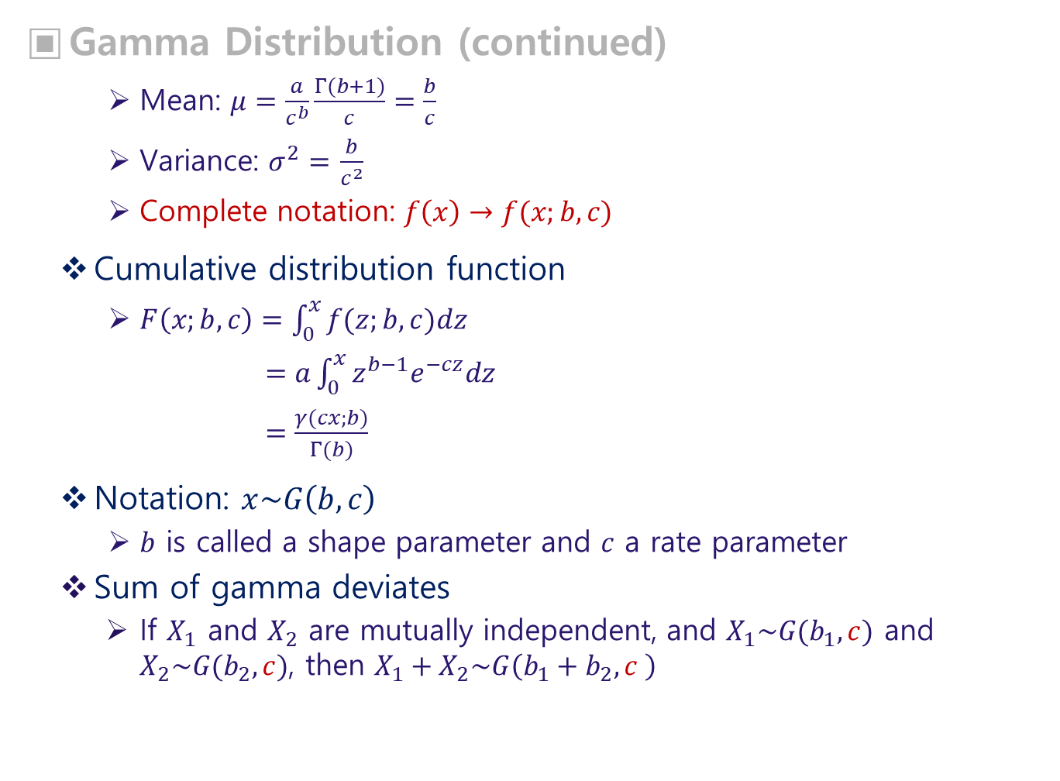
Gamma Distribution (continued)
Mean: $μ=\frac{a}{c^{b}}\frac{Γ(b+1)}{c}=\frac{b}{c}$
Variance: $σ^{2}=$ $\frac{b}{c^{2}}$
Complete notation: $f\left(x\right)→f(x;b,c)$
Cumulative distribution function
$F\left(x;b,c\right)=\int_{0}^{x}{f(z;b,c)dz}$
$=a\int_{0}^{x}{z^{b−1}e^{−cz}dz}$
$=\frac{γ(cx;b)}{Γ(b)}$
Notation: $x\sim G\left(b,c\right)$
$b$ is called a shape parameter and $c$ a rate parameter
Sum of gamma deviates
If $X_{1}$ and $X_{2}$ are mutually independent, and $X_{1}\sim G(b_{1},c)$ and $X_{2}\sim G(b_{2},c)$, then $X_{1}+X_{2}\sim G\left(b_{1}+b_{2},c \right)$

Slide 38
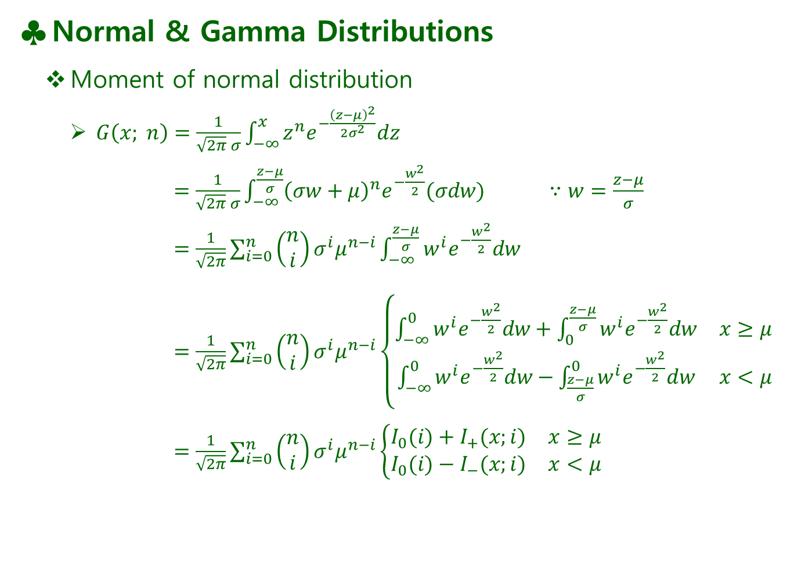
Normal & Gamma Distributions
Moment of normal distribution
$G\left(x; n\right)=\frac{1}{\sqrt{2π} σ}\int_{−∞}^{x}{z^{n}e^{−\frac{{\left(z−μ\right)}^{2}}{2σ^{2}}}dz}$
$=\frac{1}{\sqrt{2π} σ}\int_{−∞}^{\frac{z−μ}{σ}}{{\left(σw+μ\right)}^{n}e^{−\frac{w^{2}}{2}}(σdw)}$ $∵w=\frac{z−μ}{σ}$
$=\frac{1}{\sqrt{2π}}\sum_{i=0}^{n}{\left(\begin{matrix}n \\ i\end{matrix}\right)σ^{i}μ^{n−i}}\int_{−∞}^{\frac{z−μ}{σ}}{w^{i}e^{−\frac{w^{2}}{2}}dw}$
$=\frac{1}{\sqrt{2π}}\sum_{i=0}^{n}{\left(\begin{matrix}n \\ i\end{matrix}\right)σ^{i}μ^{n−i}}\left\{\begin{matrix}\int_{−∞}^{0}{w^{i}e^{−\frac{w^{2}}{2}}dw}+\int_{0}^{\frac{z−μ}{σ}}{w^{i}e^{−\frac{w^{2}}{2}}dw} & x≥μ \\ \int_{−∞}^{0}{w^{i}e^{−\frac{w^{2}}{2}}dw}−\int_{\frac{z−μ}{σ}}^{0}{w^{i}e^{−\frac{w^{2}}{2}}dw} & x<μ\end{matrix}\right.$
$=\frac{1}{\sqrt{2π}}\sum_{i=0}^{n}{\left(\begin{matrix}n \\ i\end{matrix}\right)σ^{i}μ^{n−i}}\left\{\begin{matrix}I_{0}(i)+I_{+}(x;i) & x≥μ \\ I_{0}(i)−I_{−}(x;i) & x<μ\end{matrix}\right.$

Slide 39
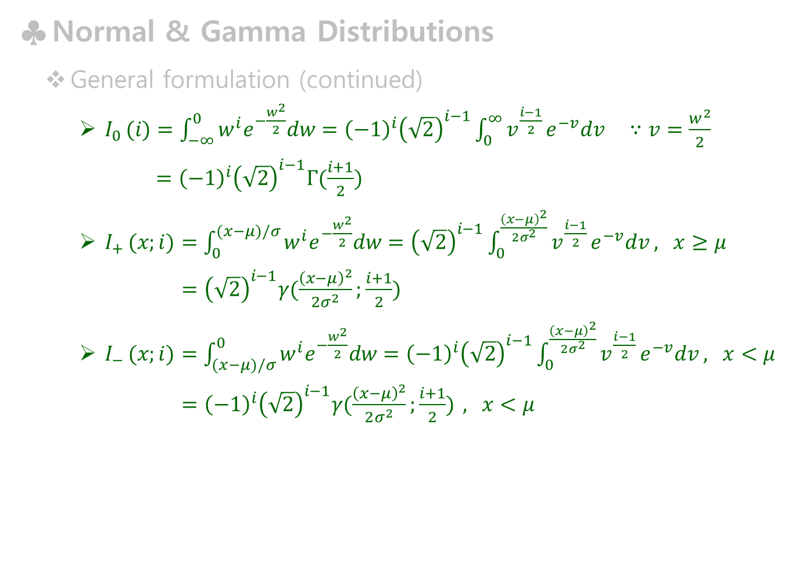
Normal & Gamma Distributions
General formulation (continued)
$I_{0 }(i)=\int_{−∞}^{0}{w^{i}e^{−\frac{w^{2}}{2}}dw}={\left(−1\right)}^{i}{\left(\sqrt{2}\right)}^{i−1}\int_{0}^{∞}{v^{\frac{i−1}{2}}}e^{−v}dv$ $∵v=\frac{w^{2}}{2}$
$={\left(−1\right)}^{i}{\left(\sqrt{2}\right)}^{i−1}Γ(\frac{i+1}{2})$
$I_{+ }(x;i)=\int_{0}^{(x−μ)/σ}{w^{i}e^{−\frac{w^{2}}{2}}dw}={\left(\sqrt{2}\right)}^{i−1}\int_{0}^{\frac{{\left(x−μ\right)}^{2}}{2σ^{2}}}{v^{\frac{i−1}{2}}}e^{−v}dv$ , $x≥μ$
$={\left(\sqrt{2}\right)}^{i−1}γ(\frac{{\left(x−μ\right)}^{2}}{2σ^{2}};\frac{i+1}{2})$
$I_{− }(x;i)=\int_{(x−μ)/σ}^{0}{w^{i}e^{−\frac{w^{2}}{2}}dw}={\left(−1\right)}^{i}{\left(\sqrt{2}\right)}^{i−1}\int_{0}^{\frac{{\left(x−μ\right)}^{2}}{2σ^{2}}}{v^{\frac{i−1}{2}}}e^{−v}dv$ , $x<μ$
$={\left(−1\right)}^{i}{\left(\sqrt{2}\right)}^{i−1}γ(\frac{{\left(x−μ\right)}^{2}}{2σ^{2}};\frac{i+1}{2})$ , $x<μ$

Slide 40
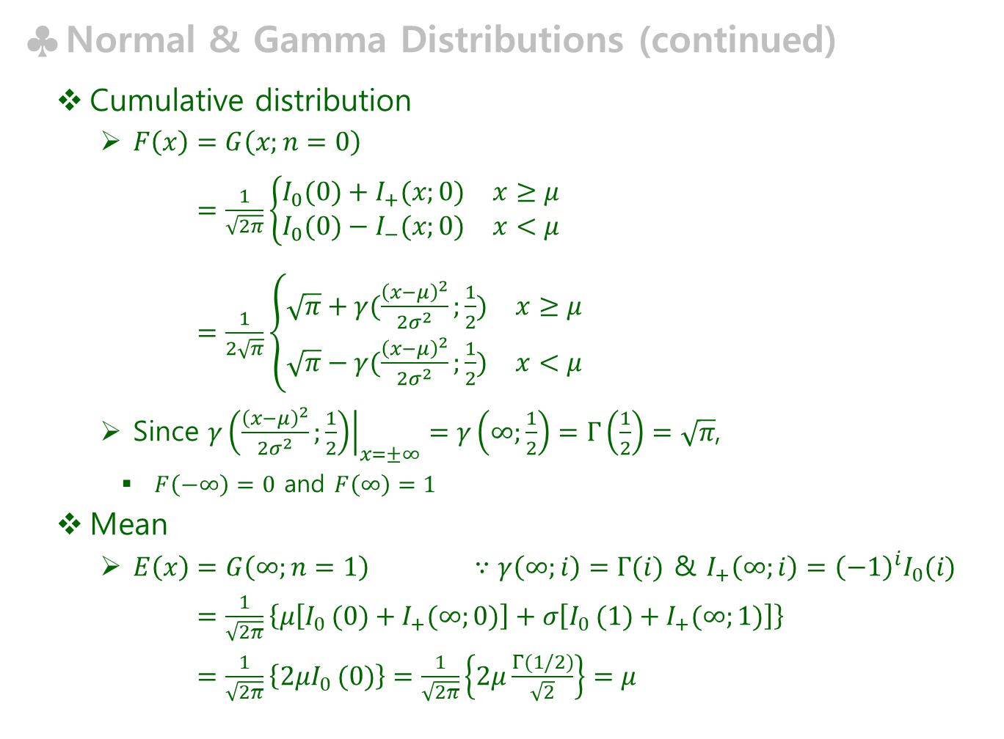
Normal & Gamma Distributions (continued)
Cumulative distribution
$F\left(x\right)=G\left(x;n=0\right)$
$=\frac{1}{\sqrt{2π}}\left\{\begin{matrix}I_{0}(0)+I_{+}(x;0) & x≥μ \\ I_{0}(0)−I_{−}(x;0) & x<μ\end{matrix}\right.$
$=\frac{1}{2\sqrt{π}}\left\{\begin{matrix}\sqrt{π}+γ(\frac{{\left(x−μ\right)}^{2}}{2σ^{2}};\frac{1}{2}) & x≥μ \\ \sqrt{π}−γ(\frac{{\left(x−μ\right)}^{2}}{2σ^{2}};\frac{1}{2}) & x<μ\end{matrix}\right.$
Since ${\left.γ\left(\frac{{\left(x−μ\right)}^{2}}{2σ^{2}};\frac{1}{2}\right)\right|}_{x=±∞}=γ\left(∞;\frac{1}{2}\right)=Γ\left(\frac{1}{2}\right)=\sqrt{π}$,
$F\left(−∞\right)=0$ and $F\left(∞\right)=1$
Mean
$E\left(x\right)=G\left(∞;n=1\right)$ $∵γ\left(∞;i\right)=Γ(i)$ & $I_{+}\left(∞;i\right)={\left(−1\right)}^{i}I_{0}(i)$
$=\frac{1}{\sqrt{2π}}\left\{μ\left[I_{0 }(0)+I_{+}(∞;0)\right]+σ\left[I_{0 }(1)+I_{+}(∞;1)\right]\right\}$
$=\frac{1}{\sqrt{2π}}\left\{2μI_{0 }(0)\right\}=\frac{1}{\sqrt{2π}}\left\{2μ\frac{Γ(1/2)}{\sqrt{2}}\right\}=μ$

Slide 41
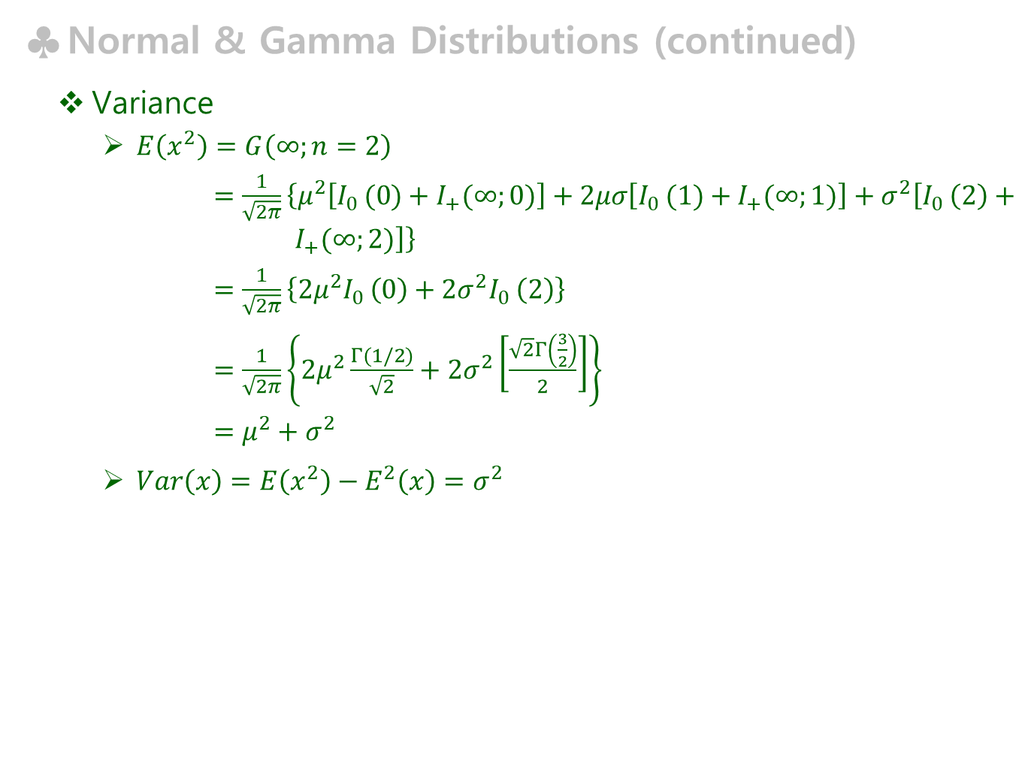
Normal & Gamma Distributions (continued)
Variance
$E\left(x^{2}\right)=G\left(∞;n=2\right)$
$=\frac{1}{\sqrt{2π}}\left\{μ^{2}\left[I_{0 }(0)+I_{+}(∞;0)\right]+2μσ\left[I_{0 }(1)+I_{+}(∞;1)\right]+σ^{2}\left[I_{0 }\left(2\right)+ I_{+}(∞;2)\right]\right\}$
$=\frac{1}{\sqrt{2π}}\left\{2μ^{2}I_{0 }\left(0\right)+2σ^{2}I_{0 }\left(2\right)\right\}$
$=\frac{1}{\sqrt{2π}}\left\{2μ^{2}\frac{Γ(1/2)}{\sqrt{2}}+2σ^{2}\left[\frac{\sqrt{2}Γ\left(\frac{3}{2}\right)}{2}\right]\right\}$
$=μ^{2}+σ^{2}$
$Var\left(x\right)=E\left(x^{2}\right)−E^{2}\left(x\right)=σ^{2}$

Slide 42
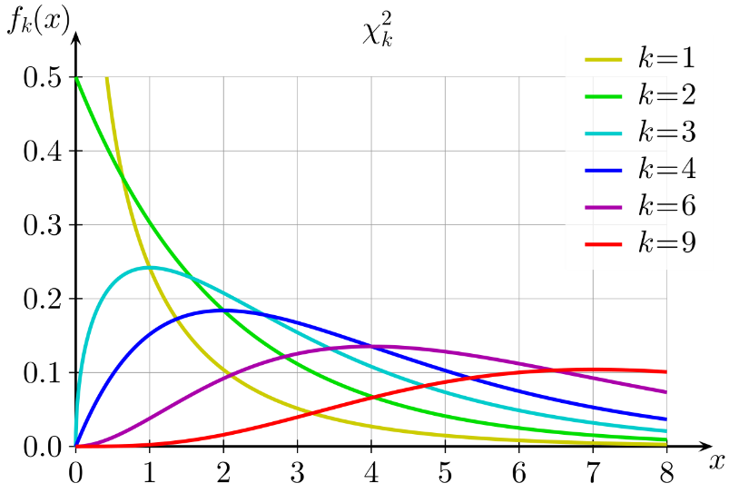
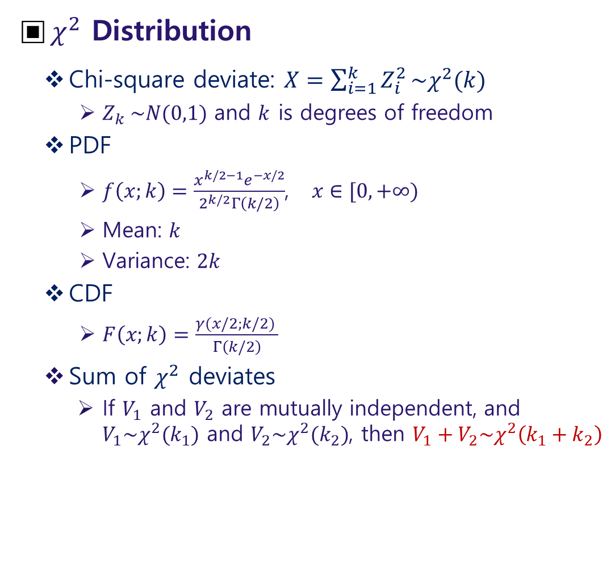
$χ^{2}$ Distribution
Chi-square deviate: $X=\sum_{i=1}^{k}{Z_{i}^{2}}\sim χ^{2}(k)$
$Z_{k} \sim N(0,1)$ and $k$ is degrees of freedom
PDF
$f\left(x;k\right)=\frac{x^{k/2−1}e^{−x/2}}{2^{k/2}Γ\left(k/2\right)}$, $x∈[0,+∞)$
Mean: $k$
Variance: $2k$
CDF
$F\left(x;k\right)=\frac{γ(x/2;k/2) }{Γ\left(k/2\right)}$
Sum of $χ^{2}$ deviates
If $V_{1}$ and $V_{2}$ are mutually independent, and $V_{1}\sim χ^{2}(k_{1})$ and $V_{2}\sim χ^{2}(k_{2})$, then $V_{1}+V_{2}\sim χ^{2}\left(k_{1}+k_{2}\right)$
<from Wikipedia>

Slide 43
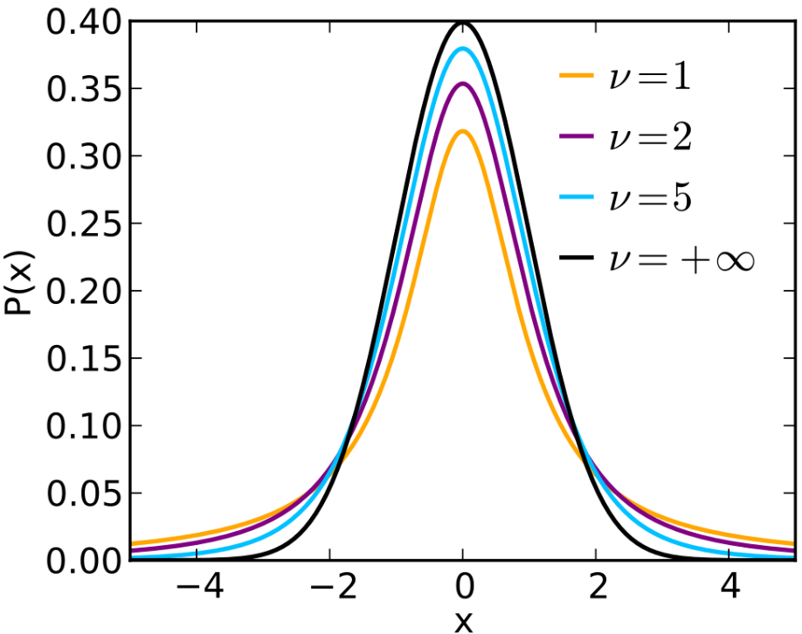

Student $t$ Distribution
Student $t$ deviate: $T=\frac{Z}{\sqrt{χ^{2}(ν)/ν}}$
$Z\sim N\left(0,1\right)$PDF: $f\left(t;ν\right)=\frac{Γ\left(\frac{ν+1}{2}\right)}{\sqrt{πν}Γ\left(\frac{ν}{2}\right)}{\left(1+\frac{t^{2}}{ν}\right)}^{−\frac{ν+1}{2}}$
Mean: 0 for $ν>1$, otherwise undefined
Variance: $\frac{ν}{ν−2}$ for $ν>2$; $∞$ for $2<ν≤4$; otherwise undefined
Usage
To test a location of distribution
<from Wikipedia>

Slide 44


$F$ Distribution
Definition
F deviate: $F=\frac{χ^{2}(ν_{1})/ν_{1}}{χ^{2}(ν_{2})/ν_{2}}\sim F(ν_{1},ν_{2})$
PDF: $F\left(x;ν_{1},ν_{2}\right)=\frac{1}{xF\left(\frac{ν_{1}}{2},\frac{ν_{2}}{2}\right)}\sqrt{\frac{{(ν_{1}x)}^{ν_{1}}ν_{2}^{ν_{2}}}{{(ν_{1}x+ν_{2})}^{ν_{1}+ν_{2}}}}$
Mean: $\frac{ν_{2}}{ν_{2}−2}$ for $ν_{2}>2$
Variance: $\frac{2ν_{2}^{2}(ν_{1}+ν_{2}−2)}{ν_{1}{\left(ν_{2}−2\right)}^{2}(ν_{2}−4)}$ for $ν_{2}>4$
Useful properties
$1/F=\frac{V_{2}/ν_{2}}{V_{1}/ν_{1}}\sim F(ν_{2},ν_{1})$
$T^{2}=\frac{Z^{2}}{V/ν}\sim F(1,ν)$
Usage
To test a variance of distribution
<from Wikipedia>

Slide 45

Special Topics
Order Statistics
Distributions of maxima
Suppose that we have a set of $n$ random $X_{i}$ which have a PDF of $f_{X}(x)$
If $Y_{k}$ take the ordered values of $X_{i}$ such that $Y_{1}≤Y_{2}⋯≤Y_{k}⋯≤Y_{n}$, then $Y_{k}=X_{i}\sim f_{X}(x)$
Distribution functions
$Y=Y_{n}=max\left\{X_{i}\right\}$
$F_{Y}\left(y\right)=P\left(Y≤y\right)$
$=P(X_{1}≤y,X_{2}≤y,⋯,X_{n}≤y)$
$=P\left(X_{1}≤y\right) P\left(X_{2}≤y\right)⋯P(X_{n}≤y)$ if $X_{i}$ are mutually independent
$=F_{X_{1}}\left(y\right) F_{X_{2}}(y)⋯F_{X_{n}}(y)$
$={\left[F_{X}(y)\right]}^{n}$ if $X_{i}$ are identically distributed
$f_{Y}(y)=nf_{X}(y){\left[F_{X}(y)\right]}^{n−1}$

Slide 46

Order Statistics (continued)
Distribution of minima
$Z=Y_{1}=min\left\{X_{i}\right\}$
$F_{Z}\left(z\right)=P\left(Z≤z\right)=1−P(Z≥z)$
$=1−P\left(Y_{1}≥z,Y_{2}≥z,⋯,Y_{n}≥z\right)$
$=1−P\left(X_{1}≥z,X_{2}≥z,⋯,X_{n}≥z\right)$
$=1−P\left(X_{1}≥z\right) P\left(X_{2}≥z\right)⋯P(X_{n}≥z)$ mutually independent $X_{i}$
$$=1−\left[1−F_{X_{1}}\left(z\right)\right]\left[1−F_{X_{2}}(z)\right]⋯\left[1−F_{X_{n}}(z)\right]$$
$={1−\left[1−F_{X}(z)\right]}^{n}$ identically distributed $X_{i}$
$f_{Z}(z)=nf_{X}(z){\left[1−F_{X}(z)\right]}^{n−1}$
Distribution of the $k$-th maxima
$f_{Y_{k}}(y)=\frac{n!}{\left(k−1\right)!\left(n−k\right)!}f_{X}(y){\left[F_{x}(y)\right]}^{k−1}{\left[1−F_{X}(y)\right]}^{n−k}$

Slide 47

Order Statistics (continued)
Extreme Value Distributions
Distribution of smallest values
Defining the random variable $η_{n}=nF_{X}\left(z\right)$, for $u$ in $0≤u≤n$
$Γ_{n}\left(u\right)=P\left(η_{n}≤u\right)=P\left(nF_{X}\left(z\right)≤u\right)$
$=P\left(z≤F_{X}^{−1}\left(\frac{u}{n}\right)\right)$ ∵ $F_{X}(z$) is a monotonically increasing function
$=$ $F_{Z}\left(F_{X}^{−1}\left(\frac{u}{n}\right)\right)$
$={1−\left[1−F_{X}\left(F_{X}^{−1}\left(\frac{u}{n}\right)\right)\right]}^{n}=1−{\left(1−\frac{u}{n}\right)}^{n}$
As $n→∞$,
$Γ\left(u\right)=\lim_{n→∞}{Γ_{n}\left(u\right)}=1−e^{−u}, u≥0$
$γ\left(u\right)=e^{−u}, u≥0$
Distribution of the minimum, $z$ for a large $n$
Since $η_{n}$ is a monotonically increasing function of $z$, $P\left(Z≤z\right)=P\left(η_{n}≤u\right)$
$F_{Z}\left(z\right)=Γ_{n}\left(u\right)$
For a large $n$, $F_{Z}\left(z\right)≅1−e^{−u}=1−e^{−nF_{X}(z)}$

Slide 48

Order Statistics
Extreme Value Distributions
Distribution of smallest values (continued)
Example: $X$ is a uniform deviate in $[0,A]$
$F_{X}\left(x\right)=x/A → η_{n}=nF_{X}\left(z\right)=nz/A$
$F_{Z}\left(z\right)≅1−e^{−u}=1−e^{−nz/A}, z≥0$
$f_{Z}\left(z\right)≅{\frac{n}{A}e}^{−nz/A}, z≥0$
Distribution of largest values
Defining the random variable $ξ_{n}=n\left(1−F_{X}\left(y\right)\right)$, for $v$ in $0≤v≤n$
$Λ_{n}\left(v\right)=P\left(ξ_{n}≤v\right)=P\left(n\left(1−F_{X}\left(y\right)\right)≤v\right)$
$=P\left(F_{X}\left(y\right)≥1−v/n\right)$
$=P\left(y≥F_{X}^{−1}\left(1−\frac{v}{n}\right)\right)$ ∵ $F_{X}(y$) is a monotonically increasing function
$=1−F_{Y}\left(F_{X}^{−1}\left(1−\frac{v}{n}\right)\right)$
$={1−\left[F_{X}\left(F_{X}^{−1}\left(1−\frac{v}{n}\right)\right)\right]}^{n}=1−{\left(1−\frac{v}{n}\right)}^{n}$

Slide 49

Order Statistics
Extreme Value Distributions
Distribution of largest values (continued)
As $n→∞$,
$Λ\left(v\right)=\lim_{n→∞}{Λ_{n}\left(v\right)}=1−e^{−v}, v≥0$
$λ\left(v\right)=e^{−v}, v≥0$
Distribution of the maximum, $y$ for a large $n$
Since $ξ_{n}$ is a monotonically decreasing function of $y$,
$P\left(Y≤y\right)=P\left(ξ_{n}≥v\right)=1−P(ξ_{n}≤v)$
$F_{Y}\left(y\right)=1−Λ_{n}\left(v\right)$
For a large $n$, $F_{Y}\left(y\right)≅1−Λ\left(v\right)=e^{−v}=e^{−n\left(1−F_{X}(y)\right)}$
Example: $X$ is a exponential deviate in $[x_{0},∞]$
$F_{X}\left(x\right)=1−e^{−β(x−x_{0})} → ξ_{n}=n[1−F_{X}\left(y\right)]=ne^{−β(y−x_{0})}$
$F_{Y}\left(y\right)≅e^{−v}=\exp\left[−ne^{−β(y−x_{0})}\right], y≥x_{0}$
$f_{Y}\left(y\right)≅nβe^{−β(y−x_{0})}\exp\left[−ne^{−β(y−x_{0})}\right], y≥x_{0}$

Slide 50

Order Statistics
Extreme Value Distributions (continued)
Remark
In the previous example for $F_{X}\left(x\right)=1−e^{−β(x−x_{0})}$, we obtained the distribution of the largest value, $F_{Y}\left(y\right)≅e^{−v}=\exp\left[−ne^{−β(y−x_{0})}\right], y≥x_{0}$
We will derive the same results for the Poisson process
The probability of $X≥x$ is $p_{x}=1−F_{X}\left(x\right)=e^{−β(x−x_{0})}$
Assuming, during time $t$, the annual rate of events larger than $x_{0}$ is $ν_{0}$, the number of events larger than $x$ is $ν_{0}p_{x}t$
Then, the probability for the occurrence of $n$ events with $X≥x$ is
$P\left[L=l\right]=\frac{{\left(ν_{0}p_{x}t\right)}^{l}e^{−ν_{0}p_{x}t}}{l!}$
The probability that the magnitude of the largest event, $Y$ is less than $x$ is equal to the probability that there is no event larger than $x$:
$F_{Y}\left(x\right)=\exp\left[−ν_{0}p_{x}t\right]=\exp\left[−ν_{0}te^{−β(x−x_{0})}\right]$
$=\exp\left[−ne^{−β(x−x_{0})}\right]$ $∵n=ν_{0}t$
Or $F_{Y}\left(y\right)=\exp\left[−ne^{−β(y−x_{0})}\right]$, $y≥x_{0}$
Here, we didn’t assume a large number, but the Poisson process

Slide 51

Generalized Extreme Value (GEV) Distribution
Extreme value distribution (EVD) are classified into 3 types
Type I: Gumbel Distribution (also called the Gumbel-Type)
The most common EVD and has two forms: one for the minimum, and one for the maximum
It is defined in the unbounded range
Type II: Fréchet Distribution
Used to model maximum values in a data set
Its is bounded (restricted) on the lower side
Type III: Weibull Distribution
Used in assessing product reliability to model failure times and life data analysis
GEV distribution unites all the 3 types of EVD above
$F\left(x;μ,σ,ρ\right)=exp\left\{−{\left[1+ρ\left(\frac{x−μ}{σ}\right)\right]}^{−1/ρ}\right\}=e^{−t(x)}$
An EVD type is determined by the (shape) parameter $ρ$
$ρ=0$: Type I → $t\left(x\right)=e^{−\frac{x−μ}{σ}}$, $x∈(−∞,+∞)$
$ρ>0$: Type II → $t\left(x\right)={\left[1+ρ\left(\frac{x−μ}{σ}\right)\right]}^{−1/ρ}$, $x∈[μ−\frac{σ}{ρ},+∞)$
$ρ<0$: Type III → $t\left(x\right)={\left[1+ρ\left(\frac{x−μ}{σ}\right)\right]}^{−1/ρ}$, $x∈(−∞,μ−\frac{σ}{ρ}]$

Slide 52





One Function of Two Random Variables
$Z=X+Y$
$F_{Z}\left(z\right)=P\left(Z≤z\right)$
$=P(Z≤x+y)$
$=P(X+Y≤z)$
$=\int_{−∞}^{∞}{\int_{−∞}^{z−y}{f_{X,Y}\left(x,y\right)dxdy}}$
$=\int_{−∞}^{∞}{\int_{−∞}^{z−y}{f_{X}\left(x\right)f_{Y}(y)dxdy}}$
$=\int_{−∞}^{∞}{F_{X}\left(z−y\right)f_{Y}\left(y\right)dy}$
$f_{Z}\left(z\right)=\frac{∂}{∂z}\int_{−∞}^{∞}{F_{X}\left(z−y\right)f_{Y}\left(y\right)dy}$
$=\int_{−∞}^{∞}{f_{X}\left(z−y\right)f_{Y}\left(y\right)dy}$
↔ $\int_{−∞}^{∞}{f_{X,Y}\left(z−y,y\right)dy}$, if $X$ and $Y$ are not independent
$Z=X/Y$
$f_{Z}\left(z\right)=\int_{−∞}^{∞}{\left|y\right|f_{X}\left(zy\right)f_{Y}\left(y\right)dy}$ ↔ $\int_{−∞}^{∞}{\left|y\right|f_{X,y}\left(zy,y\right)dy}$
$$y$$
$$z$$
$$y=z−x$$
$$x$$

Slide 53

Central Limit Theorem
Definition
There are several versions of CLT
In probability theory, CLT states that, under appropriate conditions, the distribution of a normalized version of the sample mean converges to a standard normal distribution. This holds even if the original variables themselves are not normally distributed.
In statistics, CLT can be stated as: let $X_{1},X_{2}, ⋯,X_{n}$ denote a statistical sample from a population with mean $μ$ and variance $σ^{2}$, and let ${\overline{X}}_{n}$ denote the sample mean. Then as $n→∞$, the distribution of $\frac{\left({\overline{X}}_{n}−μ\right)}{σ/\sqrt{n}}$ is a normal distribution with mean 0 and variance 1.

Slide 54


Explanation 1
<from fiveable>
Panel A shows the population (highly skewed right and truncated at zero.
Panel B, C, D show the distribution of sample means of sizes n=15, 30, and 60, respectively (from NCBI).

Slide 55

Explanation 2
For independent uniform deviates, $U_{1},U_{2},U_{3}, ⋯$ in [0,1]
$Z_{1}=U_{1}$, $f_{Z_{1}}\left(z\right)=\left\{\begin{matrix}1, & 0≤z≤1 \\ 0, & otherwise\end{matrix}\right.$
$Z_{2}=U_{1}+U_{2}$, $f_{Z_{2}}\left(z\right)=\left\{\begin{matrix}z, & 0≤z≤1 \\ 2−z, & 1≤z≤2 \\ 0, & otherwise\end{matrix}\right.$
$Z_{3}=U_{1}+U_{2}+U_{3}$, $f_{Z_{3}}\left(z\right)=\left\{\begin{matrix}\frac{1}{2}z^{2}, & 0≤z≤1 \\ −{\left(z−\frac{3}{2}\right)}^{2}+\frac{3}{4}, & 1≤z≤2 \\ \frac{1}{2}{\left(z−3\right)}^{2}, & 2≤z≤3 \\ 0, & otherwise\end{matrix}\right.$
$Z_{n}=\sum_{i=1}^{n}{U_{i}}$, $f_{Z_{n}}\left(z\right)→normal distribution$ as $n→∞$

Slide 56


Explanation 2 (continued)
Even $Z_{3}$almost resembles a normal distribution
Note that the range of $z$ increases as increasing $n$

Slide 57
Chapter 2 Estimation

Slide 58

Introduction
Sample
Each sample $X_{i}$ is a random variable
Value $x_{i}$ of a sample $X_{i}$ is a realization of $X_{i}$
The set $\left\{X_{1},X_{2}, ⋯,X_{n}\right\}$ is called a random sample of $X$, of which size is $n$
Point estimation
The value of some parameter $θ$ (i.e., mean or variance) can be estimated using a function of the random sample $\left\{X_{1},X_{2}, ⋯,X_{n}\right\}$
The function used to estimate $θ$, $\hat{θ}=\hat{θ}(X_{1},X_{2}, ⋯,X_{n})$ is called an estimator of $θ$, and said to be a point estimator
If $E\left(\hat{θ}\right)=θ$, then $\hat{θ}$ is called an unbiased estimator
If the variance of $\hat{θ}$ is smaller, then $\hat{θ}$ is said to be more efficient
If $\lim_{n→∞}{P\left\{\left|\hat{θ}−θ\right|<ε\right\}=1}$ for an arbitrary positive $ε$, then $\hat{θ}$ is called an consistent estimator

Slide 59





Interval estimation
The point estimate may deviate from the actual parameter value
To obtain an estimate with a high confidence, it is necessary to construct an interval estimate such that the interval includes the actual parameter value with a high probability
Given an estimator $\hat{θ}$, if
$P\left(\hat{θ}−e_{1}<θ<\hat{θ}+e_{2}\right)=β$
The interval $(\hat{θ}−e_{1}, \hat{θ}+e_{2})$ is said to be $100×β$ percent confidence interval for $θ$, and $β$ is called the confidence coefficient or confidence level
For a statistical test, it is more convenient to use $1−α$ in place of $β$
$$α/2$$
$$β=1−α$$
$$α/2$$

Slide 60

Point Estimation
Maximum Likelihood Method (MLM)
Condition
The functional form of the PDF of the random variable is known
Assumption
MLM is to choose an estimator such that the observed sample is the most likely to occur among all possible samples
General properties
Usually produces estimators that have minimum variance and consistency properties
If the sample size is small, however, the estimator may be biased
Formulation
Assuming $X$ has a PDF $f(x|θ)$, where $θ$ is an unknown parameter to be estimated,
The likelihood function to be maximized over $θ$ is
$L\left(θ\right)=\prod_{i=1}^{n}{f(x_{i}|θ)}$

Slide 61

Maximum Likelihood Method (continued)
Formulation (continued)
Easier way is to work with log-likelihood
$\ln{L\left(θ\right)}=\sum_{i=1}^{n}{\ln{f(x_{i}|θ)}}$
Two conditions to maximize the likelihood function
$\frac{∂}{∂θ}\ln{L(θ)}=0$ and $\frac{∂^{2}}{∂θ^{2}}\ln{L(θ)}<0$
Estimation of variance, for large $n$
$Var\left(\hat{θ}\right)=−{\left[\frac{∂^{2}}{∂θ^{2}}\ln{L(θ)}\right]}_{θ=\hat{θ}}^{−1}$
Example
Assuming $X$ is exponentially distributed with a rate $λ$,
$L\left(λ\right)=\prod_{i=1}^{n}{λe^{−λx_{i}}}=λ^{n}\exp\left(−λ\sum_{i=1}^{n}{x_{i}}\right)$ or
$\ln{L\left(λ\right)}=n\ln{λ}−λ\sum_{i=1}^{n}{x_{i}}$
Differentiating once and twice
$\frac{∂}{∂λ}\ln{L(λ)}=\frac{n}{λ}−\sum_{i=1}^{n}{x_{i}}$, $\frac{∂^{2}}{∂λ^{2}}\ln{L(λ)}=−\frac{n}{λ^{2}}<0$

Slide 62

Maximum Likelihood Method (continued)
Example (continued)
Setting the 1st derivative equal to 0, we have
$\frac{∂}{∂λ}\ln{L(λ)}=\frac{n}{λ}−\sum_{i=1}^{n}{x_{i}}=0$ or
$\hat{λ}=\frac{n}{\sum_{i=1}^{n}{x_{i}}}=1/\overline{x}$
Using the 2nd derivative to calculate the variance of $\hat{λ}$
$\frac{∂^{2}}{∂λ^{2}}\ln{L(λ)|_{λ=\hat{λ}}}=−\frac{n}{{\hat{λ}}^{2}}=−\frac{{\overline{x}}^{2}}{n}$
$Var\left(\hat{λ}\right)=−{\left[\frac{∂^{2}}{∂λ^{2}}\ln{L\left(λ\right)}\right]}_{λ=\hat{λ}}^{−1}=\frac{n}{{\overline{x}}^{2}}$

Slide 63

Method of Moments
Advantages
The procedure is fairly simple and the estimators are consistent
Disadvantages
The estimators are often biased
Definitions of moments
Population moments
$m_{k}=E\left(X^{k}\right)=\int{x^{k}f_{X}\left(x | θ\right)dx}$
Sample moments
${\hat{m}}_{k}=\frac{1}{n}\sum_{i=1}^{n}{{\left(x_{i}\right)}^{k}}$
Note that
the above definitions at centered at the origin
one can use the moments centered at the location (mean)

Slide 64

Method of Moments (continued)
Formulation
If there are $k$ parameters to be estimated, calculate the population moments and the sample moments up to the order $k$
Second, solve the simultaneous equations
$m_{1}={\hat{m}}_{1}$
$m_{2}={\hat{m}}_{2}$
$⋮$
$m_{k}={\hat{m}}_{k}$
Example
If $X$ is sampled from a gamma distribution, $X\sim G\left(b,c\right)$
$m_{1}=\frac{b}{c}$ ; $m_{2}=\frac{b}{c^{2}}+\frac{b^{2}}{c^{2}}$
${\hat{m}}_{1}=\frac{1}{n}\sum_{i=1}^{n}{x_{i}}=\overline{X}$ ; ${\hat{m}}_{2}=\frac{1}{n}\sum_{i=1}^{n}{x_{i}^{2}}=V^{2}+{\left(\overline{X}\right)}^{2}$
Solving for $b$ and $c$
$\hat{b}=\frac{{\left(\overline{X}\right)}^{2}}{V^{2}}$ ; $\hat{c}=\frac{\overline{X}}{V^{2}}$

Slide 65

Least-Squares Method (LSM)
Observation, prediction, and error
The sample $x_{i}$ can be regarded as the observation at $z_{i}$
The model to predict observations is $g(X|θ)$ where $θ$ is a model parameter
The error between the observation and the prediction is;
$e_{i}=x_{i}−g(z_{i}|θ)$
Sum of squared errors (SSE)
$SSE=\sum_{i=1}^{n}{{\left(e_{i}\right)}^{2}}=\sum_{i=1}^{n}{{\left(x_{i}−g(z_{i}|θ)\right)}^{2}}$
The estimator $\hat{θ}$ is the value of $θ$ that minimizes the $SSE$, and obtained by solving;
$\frac{∂}{∂θ}SSE=0$ and $\frac{∂^{2}}{∂θ^{2}}SSE>0$
Example
Prediction model: $g\left(z_{i} | θ\right)=g\left(z_{i} | a,b\right)=az_{i}+b$
Prediction error: $e_{i}=x_{i}−(az_{i}+b)$
$SSE=\sum_{i=1}^{n}{{\left(x_{i}−az_{i}−b\right)}^{2}}$

Slide 66

Least-Squares Method (continued)
Example (continued)
Parameters $a,b$that minimize the $SSE$are;
$\frac{∂SSE}{∂a}=0$ and $\frac{∂SSE}{∂b}=0$;
$\frac{∂^{2}}{∂a^{2}}SSE=2\sum_{i=1}^{n}{{z_{i}}^{2}}>0$ and $\frac{∂^{2}}{∂b^{2}}SSE=2\sum_{i=1}^{n}{1^{2}}=n>0$
Solving for $a,b$ yields;
$\hat{a}=\frac{\sum_{i=1}^{n}{(x_{i}−\overline{x})(z_{i}−\overline{z})}}{\sum_{i=1}^{n}{{(z_{i}−\overline{z})}^{2}}}$ and $\hat{b}=\overline{x}−\hat{a}\overline{z}$
where $\overline{x}=\frac{1}{n}\sum_{i=1}^{n}{x_{i}}$ and $\overline{z}=\frac{1}{n}\sum_{i=1}^{n}{z_{i}}$
Variances
$Var\left(\hat{a}\right)=\frac{σ^{2}}{n}+\frac{{\overline{z}}^{2}σ^{2}}{\sum_{i=1}^{n}{{(z_{i}−\overline{z})}^{2}}}$ $∵σ^{2}=Var\left(E\right)=\frac{\sum_{j=1}^{n}{{e_{j}}^{2}}}{n−2}=\frac{\sum_{j=1}^{n}{{\left(x_{j}−\hat{a}z_{i}−\hat{b}\right)}^{2}}}{n−2}$
$Var\left(\hat{b}\right)=\frac{σ^{2}}{\sum_{i=1}^{n}{{(z_{i}−\overline{z})}^{2}}}$

Slide 67

Least-Squares Method (continued)
MLM equivalency
If $e_{i}=x_{i}−g\left(z_{i} | θ\right)\sim N(0,σ^{2})$, the likelihood function for $e_{i}$ is
$L\left(θ\right)={\left(\sqrt{2π}σ\right)}^{−n}\prod_{i=1}^{n}{e^{−\frac{{e_{i}}^{2}}{2σ^{2}}}}={\left(\sqrt{2π}σ\right)}^{−n}\exp\left(−\frac{SSE}{2σ^{2}}\right)$
Maximization of $L\left(θ\right)$ is equivalent to minimization of the exponent which is the least-squares
Variances
$Var\left(\hat{a}\right)=\frac{{\overline{z}}^{2}σ^{2}}{\sum_{i=1}^{n}{{(z_{i}−\overline{z})}^{2}}}$ $∵σ^{2}=Var\left(E\right)=\frac{\sum_{j=1}^{n}{{\left(x_{j}−\hat{a}z_{i}−\hat{b}\right)}^{2}}}{n−2}$
$Var\left(\hat{b}\right)=\frac{σ^{2}}{\sum_{i=1}^{n}{{(z_{i}−\overline{z})}^{2}}}$

Slide 68

Least-Squares Method (continued)
Weighted least-squares method (WLSM)
If the errors are mutually independent, but not identically distributed, i.e., $e_{i}=x_{i}−g\left(z_{i} | θ\right)\sim N(0,σ_{i}^{2})$, then, from the MLM equivalency, the likelihood function for $e_{i}$ becomes
$L\left(θ\right)={\left(\sqrt{2π}σ_{i}\right)}^{−n}\exp\left(−\frac{1}{2}\sum_{i=1}^{n}{{\left(\frac{e_{i}}{σ_{i}}\right)}^{2}}\right)={\left(\sqrt{2π}σ_{i}\right)}^{−n}\exp\left(−\frac{1}{2}\sum_{i=1}^{n}{{\left(w_{i}e_{i}\right)}^{2}}\right)$
where $w_{i}=1/σ_{i}$, the weight of the $i$-th error
The above equation states that the observation with larger variance, i.e., more uncertain observation, is less weighted
Maximization of $L\left(θ\right)$ can be achieved by minimizing $\sum_{i=1}^{n}{{\left(\frac{e_{i}}{σ_{i}}\right)}^{2}}$
$χ^{2}$ estimation
Since $e_{i}\sim N(0,σ_{i}^{2})$, $X=\sum_{i=1}^{n}{{\left(\frac{e_{i}}{σ_{i}}\right)}^{2}}\sim χ^{2}\left(n−m\right)$, where $m$ is the number parameter in $θ$
This can be used to test the suitability of the model, the assumption of normality, or the data credibility (rule of thumb: $X≅n−m$; mean of $χ^{2}$)

Slide 69
Chapter 3 Hypothesis Test

Slide 70


Introduction
Statistical Hypotheses
Null hypothesis, $H_{0}$
No significance difference between the populations specified in the experiments
Alternative hypothesis, $H_{1}$
There exits sufficient evidence to support the credibility of the alternative hypothesis
Important!
$H_{0}$ & $H_{1}$ should satisfy the MECE principle
Test is carried out for $H_{0}$ → $H_{0}$ should be testable
Error Types
Table of error types |  | Null hypothesis, $H_{0}$
 |  | True | False
Decision about null hypothesis, $H_{0}$ | Not reject | Correct inference | Type II error
 | Reject | Type I error | Correct inference

Slide 71

Test Procedure
Minimization of Errors
Impossible to minimize both of type I and type II errors at the same time
The statistical decision is based on the minimization of the type I error
Significance level, $α$
Maximum allowed probability to commit the type I error
Test statistic
A quantity derived from the sample for statistical hypothesis testing
Ex: sample mean, sample variance
Rejection region (critical region)
a set of values for the test statistic for which the null hypothesis is rejected
i.e., if the observed test statistic is in the critical region then we reject the null hypothesis and accept the alternative hypothesis
It is determined per the alternative hypothesis

Slide 72













Test Procedure (continued)
One-sided test
All the rejection region corresponding to the significance level is located at the lower end or upper end of the distribution
Two-sided test
The rejection region locates at two ends by half and half
Do not reject $H_{0}$
Reject $H_{0}$
Reject $H_{0}$
Do not reject $H_{0}$
$$1−α$$
$$1−α$$
$$α$$
$$α$$
$$α$$
Rejection region
Rejection region
Reject $H_{0}$
Do not reject $H_{0}$
Reject $H_{0}$
$$\frac{α}{2}$$
$$1−α$$
$$\frac{α}{2}$$
Rejection region
Rejection region

Slide 73

Test Procedure (continued)
$p$-value
The probability that the test statistic is exceeded or falling short
The one-ended test
When the rejection region is at the upper tail
$p$-value is the probability to exceed the statistic
the null hypothesis is rejected if $p$-value is smaller than the significance level $α$
When the rejection region is at the lower tail
$p$-value is the probability not to exceed the statistic
the null hypothesis is rejected if $p$-value is smaller than the significance level $α$
The two-ended test
If $p$-value is greater than the significance level $α/2$ or smaller than $1−α/2$, the null hypothesis is rejected
The smaller the $p$-value, the smaller the Type I error potential
Null hypothesis is not rejected when the $p$-value exceeds the significance level $α$

Slide 74

Test Examples
Test of Population Mean Estimate
Distribution of sample mean
For $\overline{X}=\frac{1}{n}\sum_{i=1}^{n}{X_{i}}$, we know that $E\left(\overline{X}\right)=μ$ and $Var\left(\overline{X}\right)=\frac{σ^{2}}{n}$
For large $n$, from CLT, $\overline{X}\sim N(μ,\frac{σ^{2}}{n})$, or $Z=\frac{\overline{X}−μ}{σ/\sqrt{n}}\sim N(0,1)$ if the variance of population $σ^{2}$ is known
If $σ^{2}$ is unknown, using the sample variance,
If $n$ is reasonably large (i.e., larger than 30), then $\frac{\overline{X}−μ}{\sqrt{V/n}}\sim N(0,1)$
If $n$ is smaller than 30
If $X_{i}$ is a normal deviate, then $\left(\overline{X}−μ\right)/\left(σ/\sqrt{n}\right)\sim N(0,1$) and $\frac{\left(n−1\right)V}{σ^{2}}\sim χ^{2}(n−1)$ so that
$\frac{\overline{X}−μ}{\sqrt{V/n}}=\frac{\left(\overline{X}−μ\right)/\left(σ/\sqrt{n}\right)}{\sqrt{\frac{\left(n−1\right)V}{σ^{2}}/(n−1)}}\sim t(n−1)$
If $X_{i}$ is an exponential deviate, then $2n\overline{X}/μ\sim χ^{2}(2n)$

Slide 75


Test Examples
Test statistic: $T=\frac{\overline{X}−μ_{0}}{\sqrt{V/n}}$
For significance level $α$
$z_{α}$: a value of the standard normal deviate of which probability to exceed it is $α$
$V$: sample variance
Null Hypothesis | Rejection Region
 | $$n≥30$$ | $$n<30$$
 |  | Normal $X_{i}$ | Exponential $X_{i}$
$$H_{0}: μ≤μ_{0}$$ $$H_{1}: μ>μ_{0}$$ | $\frac{\overline{X}−μ_{0}}{\sqrt{V/n}}>z_{α}$ | $\frac{\overline{X}−μ_{0}}{\sqrt{V/n}}>t_{α}(n−1)$ | $\frac{2n\overline{X}}{μ_{0}}>χ_{α}^{2}(2n)$
$$H_{0}: μ≥μ_{0}$$ $$H_{1}: μ<μ_{0}$$ | $\frac{\overline{X}−μ_{0}}{\sqrt{V/n}}<−z_{α}$ | $\frac{\overline{X}−μ_{0}}{\sqrt{V/n}}<−t_{α}(n−1)$ | $\frac{2n\overline{X}}{μ_{0}}<χ_{1−α}^{2}(2n)$
$$H_{0}: μ=μ_{0}$$ $$H_{1}: μ≠μ_{0}$$ | $\left|\frac{\overline{X}−μ_{0}}{\sqrt{V/n}}\right|>z_{α/2}$ | $\left|\frac{\overline{X}−μ_{0}}{\sqrt{V/n}}\right|>t_{α/2}(n−1)$ | $\frac{2n\overline{X}}{μ_{0}}>χ_{α/2}^{2}(2n)$ or $\frac{2n\overline{X}}{μ_{0}}<χ_{1−α/2}^{2}(2n)$

Slide 76










For $\overline{X}$, ${μ<μ}_{0}$
For $Z=\frac{\overline{X}−μ}{σ\sqrt{n}},Z_{0}=\frac{\overline{X}−μ_{0}}{σ\sqrt{n}}$ ; if ${μ<μ}_{0}$, $z>z_{0}$ and ${p<p}_{0}$
Smaller Type I error potential for $Z$
$$α$$
$$μ$$
$$μ_{0}$$
$$z_{α}$$
$$z_{α}$$
$$z_{α}$$
$$z$$

Slide 77

Distribution of Sample Mean & Variance
Sample Variance
For unknown population mean $μ$, we have $V=\frac{1}{n−1}\sum_{i=1}^{n}{{\left(X_{i}−\overline{X}\right)}^{2}}$
If $\frac{X_{i}−μ}{σ}\sim N(0,1)$, then $\sum_{i=1}^{n}{{\left(\frac{X_{i}−μ}{σ}\right)}^{2}}\sim χ^{2}\left(n\right)$
$\sum_{i=1}^{n}{{\left(\frac{X_{i}−μ}{σ}\right)}^{2}}=\sum_{i=1}^{n}{{\left(\frac{X_{i}−\overline{X}}{σ}\right)}^{2}}+n{\left(\frac{\overline{X}−μ}{σ}\right)}^{2}$
$=\frac{\left(n−1\right)V}{σ^{2}}+$ ${\left(\frac{\overline{X}−μ}{σ/\sqrt{n}}\right)}^{2}$
Since ${\left(\frac{\overline{X}−μ}{σ/\sqrt{n}}\right)}^{2}\sim χ^{2}\left(1\right)$ ,it follows that $\frac{\left(n−1\right)V}{σ^{2}} \sim χ^{2}\left(n−1\right)$

Slide 78


Test statistic: $T=\frac{\left(n−1\right)V}{σ_{0}^{2}}$
For significance level $α$
If $X_{i}$ follows the normal distribution
$χ_{α}^{2}(n−1)$: a value of the Chi-square deviate of $(n−1)$ degrees of freedom, of which probability to exceed it is $α$
Null Hypothesis | Rejection Region
$$H_{0}:σ^{2}≤σ_{0}^{2}$$ | $\frac{\left(n−1\right)V}{σ_{0}^{2}}>χ_{α}^{2}(n−1)$
$$H_{0}:σ^{2}≥σ_{0}^{2}$$ | $\frac{\left(n−1\right)V}{σ_{0}^{2}}<χ_{1−α}^{2}(n−1)$
$$H_{0}:σ^{2}≠σ_{0}^{2}$$ | $\frac{\left(n−1\right)V}{σ_{0}^{2}}>χ_{α/2}^{2}(n−1)$ or$\frac{\left(n−1\right)V}{σ_{0}^{2}}<χ_{1−α/2}^{2}(n−1)$

Slide 79








Test statistic: $X=\frac{\left(n−1\right)V}{σ^{2}}\sim χ^{2}\left(n−1\right)$
If $σ$< $σ_{0}$, then $x>x_{0}$ and ${p<p}_{0}$
Smaller Type I error potential for $Z$
$$1−α$$
$$α$$
$$0$$
$$χ_{α}^{2}$$
$$x_{0}$$
$$x$$

Slide 80

Test of Distributions
Chi-square test
Used for the grouped data
Pearson’s test statistic: $PTS=\sum_{n}^{N}{\frac{{\left(O_{n}−E_{n}\right)}^{2}}{E_{n}}}\sim χ^{2}(N−M)$
$O_{n}$ : observed frequency
$E_{n}$ : expected frequency from the assumed distribution
$M$ = 1+constraints related to estimation of parameters of the distribution
Kolmogorov-Smirnov test
Used for the continuous data
Test statistic: $D=max\left|S(x_{n})−F(x_{n})\right|, n=1, 2, ⋯, N$
$x_{n}$ : observation in ascending order
$S\left(x_{n}\right)=n/N$ : empirical cumulative distribution
$F(x_{n})$ : cumulative distribution of the assumed distribution
$\operatorname{Pr}\left(D>d\right)=Q(\sqrt{N}d)$
$Q\left(x\right)=2\sum_{j=1}^{∞}{{(−1)}^{j−1}e^{−2j^{2}x^{2}}}$
Shapiro-Wilk test: specific to the test of the normality

Slide 81

Examples
Average (mean) lifetime of bulbs
Situation: a company states that the average lifetime of their bulbs is longer than 1950 h
Task: given the $n=9$ samples with $\overline{X}=1966.7$ and $V={69.6}^{2}$, test the hypothesis with the significance level 0.05
Test statistic
$T=\frac{\overline{X}−μ}{\sqrt{V/N}}$
Distribution of test statistic for $n=9 (<30)$:
$T=\frac{\overline{X}−μ}{\sqrt{V/N}}\sim t\left(n−1\right)=t(8)$
Hypotheses
$H_{0}: μ≤μ_{0}=1950$ $H_{1}: μ>μ_{0}=1950$
Rejection region
$τ=\frac{\overline{X}−μ_{0}}{\sqrt{V/N}}=\frac{1966.7−1950}{\sqrt{69.6/9}}=0.720$
Since $t_{0.05}\left(8\right)=1.86>τ=0.720$, $H_{0}$ cannot be rejected.

Slide 82

Examples (continued)
Variance of thickness of window glasses
Situation: an investigator reports $σ^{2}>{1.5}^{2}$ due to malfunction of machines
Given the $n=$10 samples with the sample variance $v=5.1556$ and the thickness follows the normal distribution, test the report with the significance level 0.05
Test statistic
$X=\frac{\left(n−1\right)V}{σ^{2}}$
Distribution of test statistic for $n=$10,
$\frac{\left(n−1\right)V}{σ^{2}}\sim χ (n−1)$ → $\frac{9V}{σ^{2}}\sim χ (9)$
Hypotheses
$H_{0}:σ^{2}≤{1.5}^{2} (=σ_{0}^{2}$) $H_{1}:σ^{2}>{1.5}^{2}$
Rejection region
$x=\frac{\left(n−1\right)v}{σ_{0}^{2}}=\frac{9×5.1556}{{1.5}^{2}}=20.6224$ and $χ_{0.05}^{2}\left(9\right)=16.919$
Since $x^{2}>χ_{0.05}^{2}\left(9\right)$, $H_{0}$ is rejected.

Slide 83

Examples (continued)
Poisson process of earthquakes (Noh, 2016)
By earthquake frequency
$H_{0}:$ earthquake frequency follows the Poisson process
$\operatorname{Pr}\left(N=n\right)=\frac{{(λt)}^{n}e^{−λt}}{n!}$
$t$ : exposure time; $λ$ : mean annual rate
Test statistic: $PTS=\sum_{n=0}^{N}{\frac{{\left(O_{n}−E_{n}\right)}^{2}}{E_{n}}}\sim χ^{2}(N−2)$
$O_{n}$ : observed frequency of time intervals in which earthquakes occurred $n$ times
$E_{n}$ : expectation of $O_{n}$, i.e., $E_{n}=\operatorname{Pr}\left(N=n\right)×(\# of time intervals)$
$M=2$: 1 + a constraint related to estimation of $λ$
$H_{0}$is rejected if $PTS>χ_{α}^{2}(N−1)$
By inter-event time
$\operatorname{Pr}\left(N=0)=e^{−λt}=Pr⁡(T>t\right)=1−F(t)$
Test statistic: $D=max\left|S(t_{i})−F(t_{i})\right|, i=1, 2, ⋯, n$
$t_{i}$ : observed inter-event time in ascending order
$S\left(t_{i}\right)=i/n$ : empirical cumulative distribution
$\operatorname{Pr}\left(D>d_{obs}\right)=Q(\sqrt{n} d_{obs})$
$Q\left(ε\right)=2\sum_{j=1}^{∞}{{(−1)}^{j−1}e^{2j^{2}ε^{2}}}$
$H_{0}$is rejected if $Q\left(\sqrt{n}{ d}_{obs}\right)<α$

Slide 84


Examples
Poisson process of earthquakes (Noh, 2016))

Slide 85
Chapter 4 Monte Carlo Simulation

Slide 86
What is the Monte Carlo Simulation?
Definition 1
A statistical technique used to model and analyze the impact of uncertainty and variability in complex systems or processes
It involves running a large number of simulations to estimate possible outcomes and their probabilities, often when the problem involves randomness or uncertainty
Definition 2
A computational technique used to model and analyze systems or processes that involve uncertainty, randomness, or complex variables
It leverages random sampling and statistical analysis to approximate numerical results, often for problems that are difficult or impossible to solve analytically

Slide 87


Transform of PDF
Parametric Function
$M=g(U)$
where $M$ and $U$ are random variable
Transform from $f_{U}(u)$ to $f_{M}(m)$
$P\left(m<M<m+dm\right)=P\left(u_{1}<U<u_{1}+du_{1}\right)+P\left(u_{2}+du_{2}<U<u_{2}\right)$+$P\left(u_{3}<U<u_{3}+du_{3}\right)$ $∵du_{1},du_{3}>0;du_{2}<0$
$P\left(m<M<m+dm\right)=f_{M}\left(m\right)dm$
$P\left(u_{i}<U<u_{i}+du_{i}\right)=f_{U}\left(u_{i}\right)\left|du_{i}\right|$,
$f_{M}\left(m\right)dm=f_{U}\left(u_{1}\right)\left|du_{1}\right|+f_{U}\left(u_{2}\right)\left|du_{2}\right|$
$+f_{U}(u_{3})\left|du_{3}\right|$
$f_{M}\left(m\right)=\frac{f_{U}\left(u_{1}\right)}{\left|g′(u_{1})\right|}+\frac{f_{U}\left(u_{2}\right)}{\left|g′(u_{2})\right|}+\frac{f_{U}\left(u_{3}\right)}{\left|g′(u_{3})\right|}$

Slide 88

Parametric Function (continued)
Example: $M=e^{U}$ ⇌ $u=\ln{m}$
One-to-one correspondence
$g(u)=e^{u}$ → $\left|g′(u)\right|=e^{u}=m>0$
$f_{M}\left(m\right)=\left\{\begin{matrix} 0, m≤0 \\ \frac{1}{m}f_{U}\left(\ln{m}\right), m>0\end{matrix}\right.$
If $U\sim N(μ,σ^{2})$, i.e., $f_{U}\left(u\right)=\frac{1}{\sqrt{2π}σ}e^{−\frac{{\left(u−η\right)}^{2}}{2σ^{2}}}$
$f_{M}\left(m\right)=\frac{1}{m\sqrt{2π}σ}e^{−\frac{{\left(\ln{m}−η\right)}^{2}}{2σ^{2}}}$
$η_{M}=e^{η+σ^{2}/2}$
$σ_{M}^{2}=(e^{σ^{2}}−1)e^{2η+σ^{2}}$

Slide 89

Monte Carlo Simulation
Transform Method
Uniform deviates in [0,1]
$f_{U}\left(u\right)=1, F_{U}\left(u\right)=u, for 0≤u≤1$
Parametric function: $u=F_{M}\left(m\right)$
Monotonically increasing function → solution at a single point
$0≤{u=F}_{M}(m)≤1$
$f_{U}\left(u\right)=\frac{f_{M}(m)}{\left|F_{M}^{′}(m)\right|}=1$
$U$ is an uniform deviate
$M=F_{M}^{−1}\left(U\right)$
Example
$f_{M}\left(m\right)=kβe^{−β(m−m_{min})}, m_{min}≤m≤m_{max}$
$F_{M}\left(m\right)=k\left[1−e^{−β(m−m_{min})}\right], m_{min}≤m≤m_{max}$
$M=F_{M}^{−1}\left(U\right)=m_{min}−\ln\left(1−\frac{U}{k}\right)/β, 0≤U≤1$

Slide 90


Rejection Method
Target function: $p(x)$
Target PDF: $f_{p}\left(x\right)=p(x)/A_{p}$
Comparison function: $q(x)$
$q\left(x\right)≥p\left(x\right), ∀x$
Comparison PDF: $f_{q}\left(x\right)=q(x)/A_{q}$
$F_{q}^{−1}(u)$ is an explicit function
Goal
To generate pairs of i.i.d. random variables $\left(X,Y\right)$ that uniformly distribute between $q\left(x\right)$ and $x$-axis
For independent uniform deviates $U_{1}$, $U_{2}$
$x=F_{q}^{−1}(u_{1})$ → $P\left(x≤X≤x+dx\right)=f_{q}\left(x\right)dx=\frac{q(x)}{A_{q}}dx$ (1)
$y=q(x)u_{2}$ → $P\left(y≤Y≤y+dy | x≤X≤x+dx\right)=\frac{dy}{q(x)}$ (2)
$y$ is a uniform deviate in $[0,q\left(x\right)]$ → $f_{Y}\left(y\right)=\frac{1}{q(x)}$ ; constant, given an $x$
$P\left(dY,dX\right)=P\left(dY | dX\right)P\left(dX\right)=\frac{dy}{q(x)}∙\frac{q\left(x\right)}{A_{q}}dx=\frac{dxdy}{A_{q}}$

Slide 91

Rejection Method (continued)
Simulation procedure
Generate a uniform deviate $u_{1}$ to get $x$ by (1)
Generate a uniform deviate $u_{2}$ to get $y$ by (2)
Take $x$ if $y≤p\left(x\right)$, otherwise discard $x$
Repeat to get the necessary amount of $x$’s
Useful tip
For the sake of efficiency, take the smallest $A_{q}$ as far as it meets the condition $q\left(x\right)=f_{q}\left(x\right)A_{q}≥p(x)$ at all $x$

Slide 92


Examples
Transform method for a complete catalog (Noh, 2014)
$M=F_{M}^{−1}\left(U\right)=M_{min}−\ln\left(1−\frac{U}{k}\right)/β, 0≤U≤1$
Magnitude grouping
$[m_{min},m_{max}]$ → $[m_{min}−{∆m}/2,m_{max}+{∆m}/2]$
$m_{min}=3.0$
$m_{max}=7.0$
$b=1.0$
$n_{e}=5,000$

Slide 93


Examples (continued)
Rejection method for a incomplete catalog (Noh, 2019)
Target function: $p\left(m\right)=d(m)f_{M}(m)$
Detection rate: $d\left(m\right)=\left\{\begin{matrix}c(m_{c})∙\operatorname{erf}\left(m | μ,σ\right) for m<m_{c} \\ 1, for m_{c}≤m\end{matrix}\right.$
$c\left(m_{c}\right)=1/{\operatorname{erf}{(m_{c}|μ,σ)}}$
Comparison function
$q\left(m\right)=f_{M}\left(m\right)≥p\left(m\right)$
$m_{min}=2.0, m_{max}=5.0$
$b=1.0$
$m_{c}=3.0$
$μ=5.0$, $σ=0.25$
$n_{e}=5,000$

